Slide 1
Health State Utility (HSU)
Good Practices Task Force
Recommendations for Identification and Use of HSU Data in Cost-effectiveness in Decision Modelling
ISPOR Europe 2018
12 November Barcelona, Spain

Slide 2
Task Force Members:
John Brazier, MSc, PhD, FMedSci, Dean, School of Health and Related Research (ScHARR) University of Sheffield, Sheffield, England, UK
Roberta Ara, MSc, Senior Research Fellow, University of Sheffield, Sheffield, England, UK
Ismail Azzabi, MSc, MAS, Senior Manager Global Health Economics, Takeda Pharmaceutical International AG, Zurich, Switzerland
Hélène Chevrou-Séverac, PhD, Director HEOR Medical Affairs, Celgene International,
Sàrl, Switzerland
Bruce Crawford, MA, MPH, Vice President, Real World Evidence, APAC, Syneos Health,
Tokyo, Japan
Luciane Cruz, ScD, PhD, Health Technology Assessment Institute, Federal University of Rio Grande du Sol, Porto Alegre, Brazil
John Karnon, MSc, PhD, Professor of Health Economics, The University of Adelaide, Adelaide, Australia
Notes:
We change the color slightly for speakers.

Slide 3
Task Force Members continued…
Luciane Cruz, ScD, PhD, Health Technology Assessment Institute, Federal University of Rio Grande du Sol, Porto Alegre, Brazil
John Karnon, MSc, PhD, Professor of Health Economics, The University of Adelaide, Adelaide, Australia
Andrew Lloyd, DPhil, Director, Acaster Lloyd Consulting Ltd, Oxford, England, UK
Suzy Paisley, MA, PhD, Senior Research Fellow, Director of Information Resources, University of Sheffield, Sheffield, England, UK
A. Simon Pickard, PhD, Professor & Director, Graduate Studies, Department of Pharmacy Systems, Outcomes and Policy, College of Pharmacy, University of Illinois at Chicago, Chicago, IL, USA
Jan Busschbach, PhD, Professor & Chair of the section Medical Psychology & Psychotherapy, Erasmus University Medical Center; Senior Investigator, Viersprong Institute for Studies of Personality Disorders (VISPD), Netherlands
Notes:
This doesn’t make sense. Either change the header or delete objective

Slide 4
Current Reporting Standards: recent review
Example: review of reporting standards associated with HSUs used in recently published (2015-2018) cost-effectiveness analyses using case-study in cardiovascular disease
See summary in:
Ara R, Brazier J, Lloyd A, Chevrou-Severac H. How health state utilities used in cost-effectiveness models are currently identified, reviewed and reported. Value and Outcomes Spotlight. September/October 2018, 4(5): 31-33.

Slide 5
Current approaches to reporting HSUs used in models
No literature review (too many hits, too much effort, no-one else does)
Use outdated evidence (or just cite a value used in previous NICE submission)
Don’t cite original source (requires a detective to identify actual source: 3/4 iterations)
Don’t report actual values used (just cite any study & let reader find them if they really want to)
Never, ever provide details of source study (e.g. patient characteristics, measure used, sample size etc.)
‘Tweak’ the values (several times)
Notes:
Pose the question
How would peers, reviewers and policy makers react if the above were done for clinical evidence?
But much better to standardise practice
Current practice undermines the rational for cost per QALY
the results generated using different methods are NOT directly comparable.

Slide 6
Current approaches to reporting HSUs used in models
Assume comparator has no benefit (equivalent to baseline of full health)
Ignore adverse events (or make something up, or use evidence from a different treatment)
Add clinical effects together when using two interventions, or ignore one (equivalent to using additive or minimum method to combine HSUs for concurrent events)
Combine effects measured using different units (e.g. mmol/L & mg/dL ) (equivalent to using SF-6D, HUI & EQ-5D within same model)
Don’t bother using the values in the report in the cost-effectiveness model
Notes:
Pose the question
How would peers, reviewers and policy makers react if the above were done for clinical evidence?
But much better to standardise practice
Current practice undermines the rational for cost per QALY
the results generated using different methods are NOT directly comparable.

Slide 7
Overview of session
Presentations:
Searching, identifying & reviewing HSU for use in CE models
2. Synthesis of health state utilities
3. Using health state utilities in cost-effectiveness models
4. Minimum reporting standards - The SpRUCE checklist
5. Future Considerations
Notes:
Names are on each divider slide. Difficult to read so much text.

Slide 8
Searching, identifying & reviewing HSU for use in CE models
SECTION
1
Suzy Paisley, PhD.
School of Health and Related R
The University of Sheffield

Slide 9
A working example – C/E analysis in cardiovascular disease
Examined HSUs used in recently published (2015-2018) CE models
Also examined the reporting standards from studies included in the review
How thorough, transparent and reliable was reporting of values from literature?

Slide 10
Current Reporting Standards: Cardiovascular disease example
1/24 reported undertook literature review (limited details), 1 other referred to this review for their evidence
6/24 referenced original sources for all HSUs
  18/24 referenced previous CE studies (as opposed to original sources)
  7/24 required at least 3 iterations to track down original sources
  13/24 used at least some HSU collected in 1990s (studies all published after 2014)
4/24 correctly reported all HSUs when checked against original sources
20/24 at least some HSUs could not be matched in references or original sources, or original sources could not be identified due to incorrect referencing
0/24 provided all basic details of sources (e.g. study type, sample size, age, details of health condition, time of data collection etc.)
Ara R et al., Are current reporting standards used to describe health state utilities used in cost-effectiveness models satisfactory? Does this matter? Unpublished manuscript

Slide 11
Searching
Wide range of sources may be appropriate
  Clinical trials
  Observational studies
  Registries
  Surveys
  Previous economic evaluations
Methods must accommodate
  Needs of the model
  Needs of the decision maker

Slide 12
Model development
Model development often proceeds in an iterative fashion
Searching & identifying utilities is similar, the scope may change as model develops
  Modeller and information specialist must work together closely
Initial focused searches may be broadened in later iterations

Slide 13
Scope of searches
Evidence relevant to a model
All health states and aspects of treatment and management that might impact on health-related quality of life (HRQL)
  E.g. prophylactic treatments must include possible events in the future
Different to standard SR approach
  Standard SR approach Population – Intervention – Comparison – Outcomes (PICO).
  Scope of search typically Population + Intervention
  Scope of search for models defined by all aspects of condition and treatment pathway that might impact of HRQL

Slide 14
Search scope should account for
Health state descriptions within the model
Treatment effects of interventions and comparators of interest (treatment benefits and adverse effects)
Treatment effects and management at all stages of the clinical pathway included in the model
Carer utilities
Comorbidities
Concurrent clinical events/sequelae
General population norms
Moderators that might affect quality of life e.g., method of administration, treatment setting

Slide 15
Considerations when searching
Exhaustive searching vs searching the full scope of HRQL impact
Inconsistent search vocabulary and indexing
Which states drive model results?
  Focus resources here
  Value of information could inform when to stop searching
Transparency
  Not cherry picking

Slide 16
Selection and Reviewing
Standard SR processes
Selection (relevance)
  Study population matches model?
  Appropriateness of the measure (e.g. EQ-5D etc)
Quality assessment
  Sample size/ response rates/ loss to follow up/ missing data
  Proximity of data collection to event?
Data extraction

Slide 17
Fitting SR process to modelling process
Build in iterations
Identify key characteristics of options available
Ideal vs best available evidence
May require a trade off between different issues
Evidence to inform scenarios and sensitivity analysis
Selection rationale must be documented

Slide 18
Future developments
How much evidence are we missing?
Artificial intelligence
  Inform scope of HRQL impact
  Ranking evidence to support selection
  Automated extraction to identify key study characteristics

Slide 19
Synthesis of health state utilities
SECTION
2
Bruce Crawford, MA, MPH
Syneos Health

Slide 20
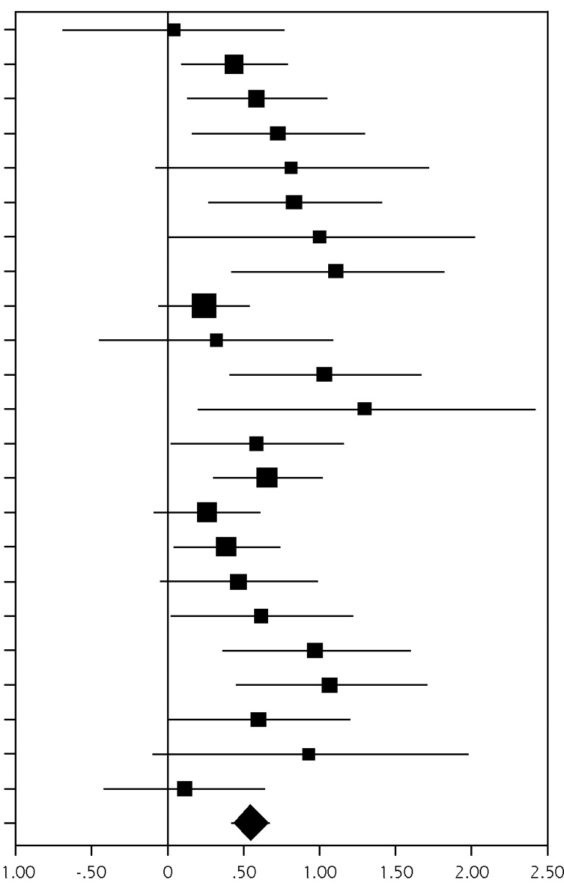
Why undertake synthesis?
Often multiple published values for a given health state
Want to use all available evidence
Synthesis should generate a more accurate estimate of the mean value and uncertainty and improve generalizability

Slide 21
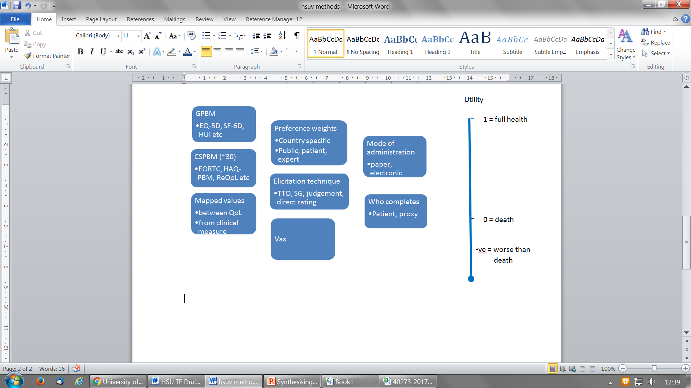
Measures and methods used to quantify utility

Slide 22
Should we undertake HSU synthesis?
Difference in HSUs instruments / methods
General preference based measures / condition-specific preference based measures
Techniques used to elicit weights differ
Mode of collection may differ
Who completes the questionnaires – proxy, patient, general public, clinician
Preference weights
Statistical techniques

Slide 23
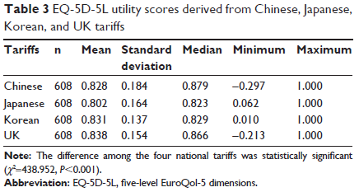
EQ-5D-5L differences by country value set
Different value sets on the same data produce significantly different results
Authors conclude that different country value sets are not interchangeable
Liu et al. Patient Preference and Adherence 2017; 11: 1049-1056

Slide 24
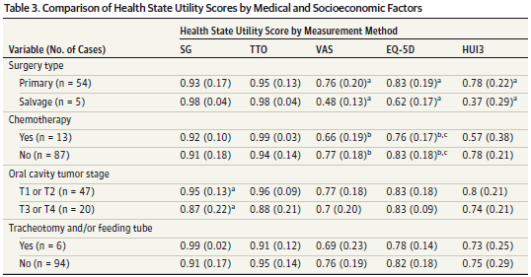
Different measures can produce vastly different results
0.07 vs 0.21 diff in utility
Noel et al. JAMA Otolaryngol Head Neck Surg 2015; 141(8): 696-703

Slide 25
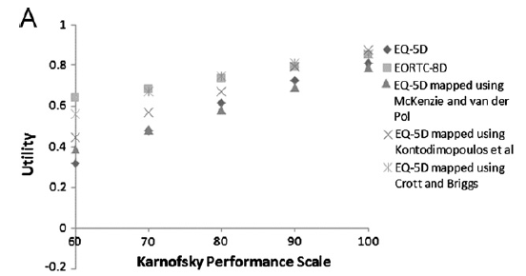
Different mapping methods produce varied utilities for the same performance level
Models may utilize functional levels such as HAQ DI levels of KPS levels, but the utility value assigned to that level can vary widely depending on the method used for utility
Rowen et al. ViH 2012; 15: 1059-1068

Slide 26
When undertake synthesis?
Are there enough HSU estimates?
Are studies sufficiently homogeneous?
Are they using the same HSUV measurement system?

Slide 27
Methods of synthesis of HSUVs
Apply strict eligibility criteria to reduce heterogeneity
  Same measurement instrument used
  Same patient group (e.g., mild, moderate, severe depression; same KPS or HAQ-DI range)
Strict eligibility is useful but considerable heterogeneity often remains
Often there are not enough studies to restrict to a single measurement instrument
Use meta-regression
  Limited to parameters reported in each manuscript
  It has been suggested that 10 studies per covariate should be used, but this is often not feasible

Slide 28

Conclusions
Currently, formal synthesis is very limited for HSUVs due to heterogeneity of valuation methods, country differences, population differences, etc.
Research still needed for methods of meta-regression in HSUV synthesis and when appropriate
When conducting synthesis:
  Limit to a single measure if possible; converting / mapping to a single measure may be useful but be aware of the additional variance introduced
  Carefully evaluate heterogeneity and model the impact if using meta-regression

Slide 29
Using health state utilities in cost-effectiveness models
SECTION
3
Helene Chevrou-Severac, PhD,
HEOR Director, Medical Affairs, Celgene International, Boudry, Switzerland

Slide 30
Current Reporting Standards: using HSUs in CE model
Baseline:
  primary prevention: 7 used age-adjusted gen pop norms (4 did not provide actual values), 6 used full health for ‘No CVD’
  secondary prevention: majority constant over time (0.76 to 0.85) for ‘history of CVD’
  7/24 impossible to tell, not reported
11/24 used different HSU for acute & chronic, huge variation in HSU across studies
  Acute (event <1yr): angina 0.63 to 0.835, MI 0.58 to 0.835, stroke 0.327 to 0.827
  Chronic(event > 1yr): angina 0.68 to 0.906, MI 0.68 to 0.965, stroke 0.39 to 0.885
Concurrent condition (e.g. MI in patients with history of stroke)
  few reported method or time period
  2 used minimum method, 1 reported they multiplied HSU together
Uncertainty
  Majority undertook PsA, majority used Beta distribution but limited details provided

Slide 31
Identifying the most appropriate health state utility (HSU) is just the beginning …………..
Issue | Recommendation
Sensitivity analysis (SA) | Always begin with SA
Discrete health states or discrete event simulation
Individual mean HSUs or function-based HSUs
Comorbidities & age
Concurrent clinical events or conditions
Treatment related adverse effects
Acute clinical events
Sensitivity analyses (again) | Always end with SA

Slide 32
Begin: sensitivity analysis
Look at the effect of each health state in model individually to inform level of literature searches
Which HSUs influence the ICER?
Communicate with search/review team which HSUs really matter

Slide 33
Model health states
Decide the format of the model in terms of numbers and types of health states that differ according to HSU
  Use clinical expertise & availability of evidence to inform decision
If simple model structure implemented that may not represent all important HSUs
  Examine & discuss expected effects of such omissions

Slide 34
Individual HSUs or function based:
Clinical events – acute? chronic? fluctuating? progressive?
Simple ‘acute’ events:
Bone fractures (e.g. hip, wrist, vertebrae)
CVD (e.g. MI, angina, stroke)
Less obvious in chronic progress conditions:
Arthritic conditions ‘flares’
Asthma exacerbations (hospitalised?)
Crohn’s disease
Age related macular degeneration
Consider:
Frequency of events
Severity of effect on QoL
Duration of time effect lasts
‘Rebound’ HSU after recovery
Timing of data collection matches acute period of event?
Explore likely effect if collection time does not match event
Notes:
Sometimes transparently clear that one can use mean HSUs as condition can be described using discrete time limited clinical events such as fractures in OP, or cardiac events in CVD
Other times less obvious whether to used mean HSUs or function. This is often in progressive conditions where effectiveness evidence from studies is in terms of a clinical variable that measures severity
Before decide discrete mean HSUs or a function, consider things on right
And the sample size available for HSU for different subgroups

Slide 35
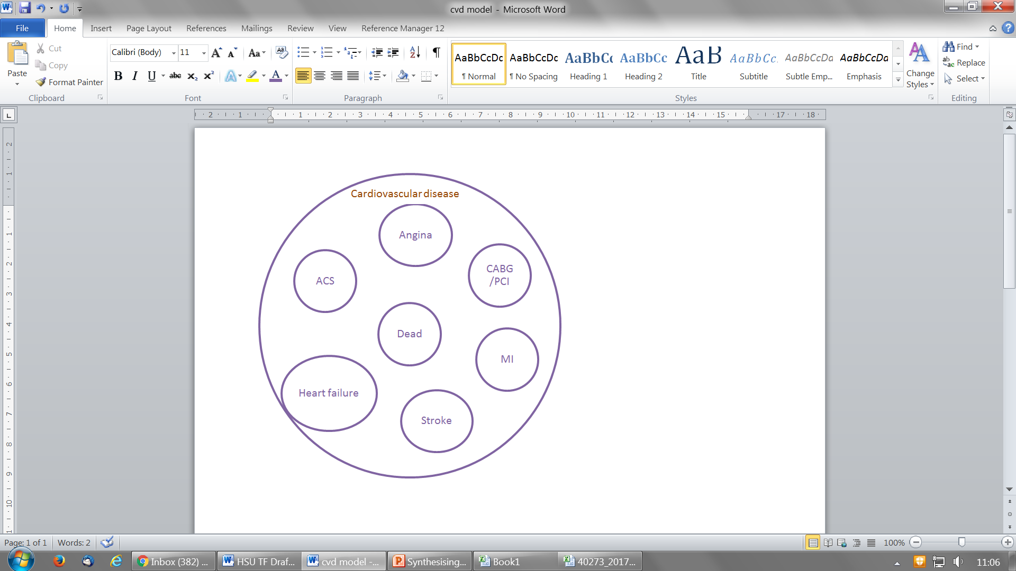
Individual HSUs, or function based?
Discrete HSUs:
Influenza
Has influenza
No influenza
Dead
Notes:
Maybe this slide is not needed
I would delete and go straight to RA, AS example

Slide 36
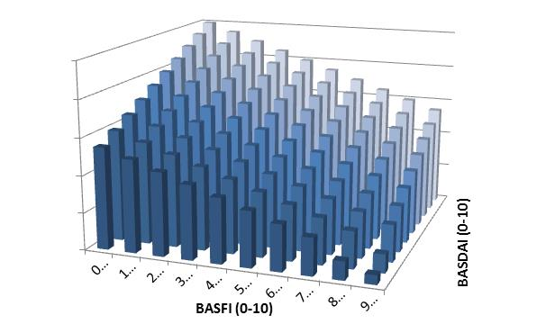
Discrete mean HSUs, or function based HSUs
Rheumatoid arthritis, measure clinical status using HAQ
Ankylosing Spondylitis, measure clinical status using both BASFI & BASDAI
A, Baseline HAQ=2.5, QoL=0.3, Start Tx1, HAQ & QoL improve
B, HAQ & QoL improve
C, HAQ progression on Tx1
D, Stop Tx1, HAQ rebounds
E, Start Tx2, HAQ & QoL improve
F, HAQ progression on Tx2
G, Stop Tx2, HAQ rebounds
AS: Both BASDAI & BASFI have strong relationship with utility.
3-D matrix, substantial sample size reqd. Use function to predict utility conditional on BASDAI & BASFI (plus age, gender ……. .
RA: HAQ strong relationship with utility.
Could use 3-30 discrete HS, depending on sample size for subgroups.
Notes:
Here have two examples where function is probably better than using mean values collected from subgroups
On left have RA, effectiveness measured using HAQ
Diagram shows how HAQ changes over time (patient responding to treatment, withdrawing from treatment HAQ reverts to baseline, getting a second treatment…..
HAQ has strong relationship with QoL
IF sample size sufficiently large, and have patients across the range of HAQ, then you could model this using evidence on QoL from subgroup (most use a function, but it could be done)
On right, Ankylosing spondylitis. Effectiveness measured using both Bath Ank Spond disease activity index and Bath Ank Spond Functional index. Range o-10. here would have a matrix for possible health states in model. Extremely unlikely sample size from trial would satisfy QoL subgrouping. Issue is underestimation of benefits of treatment if do not accurately reflect changes in QoL

Slide 37
Comorbidities, age & role of general population norms
(i.e. Baseline HSUs vary over model lifetime horizon)
Mean EQ-5D scores by age from HSE
Mean HSU is never equal to full health irrespective of measure, preference weights, age, condition or sample. Baseline of full health overestimates effects of avoiding events or conditions.
Notes:
Comorbidities increase by age and mean HSUs never = 1 ………..
On right, Dennis Fryback argued (1997) that not adjusting the baseline to account for reduction in QoL overestimates the benefit of treatment
Using full health the potential gain from avoiding condition is
Using gen pop norms the potential gain is
Many CE models use a lifetime horizon to accumulate QALYs, thus should adjust baseline to account for natural decline by age and increasing prevalence of comorbidities
(If get questioned double count – acknowledge small element of double counting, but if you take out a subgroup with a specific condition, unless huge prevalence, or huge effect on QoL, this is not going to make much difference on means for popn norms.
We have shown this in ViH 2011 and provide age adjusted by broad condition for EQ-5D
Fryback DG, Lawrence WG. Dollars may not buy as many QALYs as we think: A problem with defining quality of life adjustments. MDM 1997;17;276-284
Ara R, Brazier J. Using health state utility values from the general population to approximate baselines in decision analytic models when condition specific data are not available. ViH 2011;14(4):539-545

Slide 38
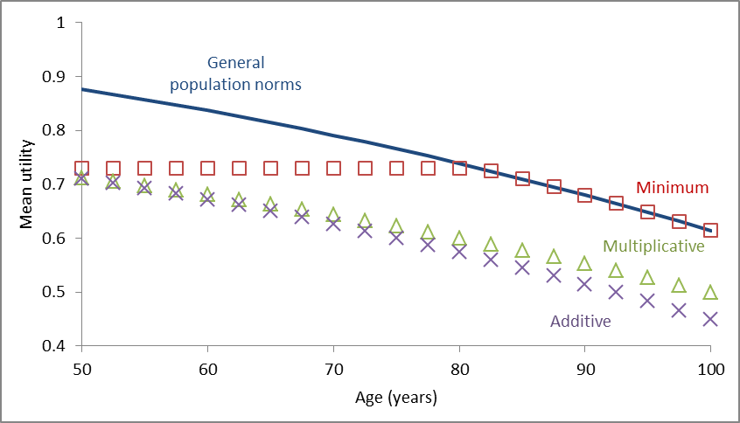
Combining HSUs when using age-adjusted baseline
NB. For multiplicative DO NOT multiply HSUs together!
Estimate ‘multiplier’ = observed mean HSU / baseline mean HSU (at age of sample).
Notes:
When combingin HSUs people typically use one of three methods
Additive constant absolute, mutiplicative constant relative decrement.
Min ignores any additional decrement
Multiplicative – cannot just multiply utilities together as people often do
See our article ViH 2011 (don’t have time here to explain
But in summary (hypothetical numbers)
Have mean EQ of 0.7 at age of 74 for condition A
Gen popn norm at age 74 is 0.8
If multiply 0.7 by 0.8 you get 0.56
But you know you need 0.7 at age of 74 in model
so you lose the one piece of information you know is correct
If you multply together
You need to get the multiplier needed for this
Ara R, Brazier J. Populating an economic model with health state utility values: moving toward better practice. ViH 2011;13(5):509-518

Slide 39
Concurrent clinical events or conditions
Ideally collect evidence from persons of interest
Condition A
Mean HSU=0.7995
Condition B
Mean HSU=0.7304
Only have mean HSUs from samples with just one of conditions (condition A, or condition B).
Estimate the HSU for the concurrent health state using HSU from Condition A, and Condition B:
It is recommended that the multiplicative method is used
Additive | =0.5903
Multiplicative | =0.6215
Minimum | =0.7304
Both Condition A
& Condition B
Mean HSU=0.6473
Notes:
Typically have mean values for people with individual conditions (comorbidities typically excluded from studies
If use these to estimate the HSU for the concurrent conditions (eg MI in someone with history of recent stroke)
Use the multiplicaive method - again don’t have time to go into details today
We have done several projects exploring this in different measures and samples
Every time multiplicative out performs other 2
Bias in errors in predicted and observed values for minimum and additive
Min underestimates true values
Additive overestimates true values
Multiplicative not perfect but much better than other two across full range
See our 2x articles or ref MDM review of all research & DSU TSD
Ara R, Wailoo AJ NICE DSU Technical Support Document 12: The use of health state utility values in decision models. 2011.
Ara R, Wailoo AJ. Estimating health state utility values for comorbid health conditions: a synopsis of the current evidence base. MDM, 2012.

Slide 40
Treatment related adverse events (AE)
CONSIDER:
Are AEs prevalent?
Do treatment related AEs have substantial effect on QoL?
  Check potential effect on ICER using SA in model.
Is effect captured in evidence used for HSUs in model?
  Those experiencing AE less likely to complete QoL measure.
  Take care not to double count effect if use trial data
What is likely duration of effect ?
  Chronic long term/ discrete short term & treatment withdrawal.
  TEST extreme values in model

Slide 41
End: sensitivity analysis (again)
ALL HSU represented by parametric probability distributions
Sample random values for PsA using Beta: rescale if –ve values possible
Consistency: for ordered values, sample using ’difference method’^{[Ren 2017]}
Univariate: test which HSUs influence ICER using CIs
Mutivariate: test LCI & UCI that move ICER in same direction
Notes:
Step 1: Sample Y and X using Betas
Step 2: Transform sampled Y and X from step 1 to unbounded range
Step 3: Sample the difference between transformed Y and X
Step 4: Back transform
Ren S, Minton J, Whyte S, Latimer N & Stevenson M (2017) A New Approach for Sampling Ordered Parameters in Probabilistic Sensitivity Analysis. PharmacoEconomics. View this article in WRRO

Slide 42
Recommendations when using health state utilities in models
Issue | Recommendation
Sensitivity analysis | Use to determine which HSUs influence the ICER & report these analysis if applicable.
Discrete health states | Expected effects of excluding potentially relevant HSUs from a cost-effectiveness model structure should be examined & discussed.
Individual mean HSUs or function-based HSUs | Relevance of data (e.g. study population, utility measures, alignment with model’s health states) Reliability of analyses (e.g. precision of mean HSUs, validity of estimated utility functions) see Wailoo et al ISPOR TF
Comorbidities & age (baseline) | Mean HSU values represent comorbidity utility effects at the mean age of the utility study population. Age-specific comorbidity effects should be estimated using age-specific population norms.
Concurrent clinical events or conditions | The multiplicative method should be used to handle the utility effects of concurrent clinical events.
Treatment related adverse effects | Assess the extent utility effects of AEs are captured by the utility data used to estimate a model’s non-adverse event . If AE HSUs are required, the range of HSUs required should be informed by expected effect on ICER.
Acute clinical events | In the absence of data collected around the event, plausible HSUs for the direct effects of acute events should be multiplied by the expected duration to assess the sensitivity of ICER to these utility effects.
Sensitivity analyses (again) | One way & multi-way SA of HSU, Beta (scaled) distributions. Difference method to account for ordering in PsA.

Slide 43
Minimum reporting standards
The SpRUCE checklist
SECTION
4
John Brazier, PhD.
ScHARR, The University of Sheffield

Slide 44

Current approaches to reporting HSUs used in models
No literature review (too many hits, too much effort, no-one else does)
Use outdated evidence (or just cite a value used in previous NICE submission)
Don’t cite original source (requires a detective to identify actual source: 3/4 iterations)
Don’t report actual values used (just cite any study & let reader find them if they really want to)
Never, ever provide details of source study (e.g. patient characteristics, measure used, sample size etc.)
‘Tweak’ the values (several times)
Assume comparator has no benefit (equivalent to baseline of full health)
Ignore adverse events (or make something up, or use evidence from a different treatment)
Add clinical effects together when using two interventions, or ignore one (equivalent to using additive or minimum method to combine HSUs for concurrent events)
Combine effects measured using different units (e.g. mmol/L & mg/dL ) (equivalent to using SF-6D, HUI & EQ-5D within same model)
Don’t bother using the values in the report in the cost-effectiveness model
Notes:
Pose the question
How would peers, reviewers and policy makers react if the above were done for clinical evidence?
But much better to standardise practice
Current practice undermines the rational for cost per QALY
the results generated using different methods are NOT directly comparable.

Slide 45
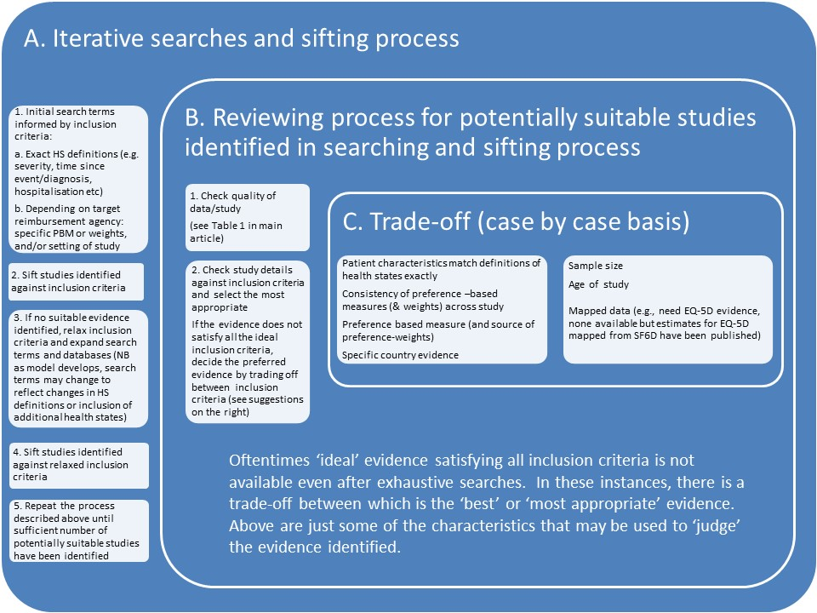
HSU identification and selection is often not a straightforward process
  Challenges to being explicit
  Iterative search and sifting process

Slide 46

SpRUCE Checklist
Provides minimum reporting standards for the Systematic Review of Utilities for Cost-Effectiveness (SpRUCE checklist).
Criteria intended to help model reviewers identify if HSU selection for the model was transparent and appropriate.
A greater level of detail is likely needed to proceed to peer-reviewed publication of a systematic review
Five sections:
  search strategy
  review process
  data extracted from each study
  basis for obtaining the final HSU
  use in cost-effectiveness models

Slide 47
SpRUCE Checklist: Search Strategy
Search Strategy
Search terms and scope | The final search strategy should be adequately defined and appropriate databases included in the search.
Study selection criteria | Explicit criteria for study identification/inclusion should be described and applied, such as patient group of interest, relevant age range and stage of disease/severity etc.

Slide 48
SpRUCE Checklist – Review Process
Review Process
Quality check | Quality criteria for reviewing studies explicitly stated and applied.
Assessment of relevance | Relevance of HSUs to model and target reimbursement agency described.

Slide 49
SpRUCE Checklist
Data Extracted (reporting of variables)
Population/patient characteristics | Relevant patient characteristics (e.g. age, sex, comorbidities, diagnosis, severity of condition).
Measure used to describe the HSUs | The measure used to obtain the HSUs.
Valuation technique for preference weights | The technique used to value the heath state (e.g. TTO, SG), and the country (provide reference).
Descriptive statistics of HSUs | The mean and variance around any HSU used in the model.
Response rates to the measure used* | Report if response rates are likely to be a threat to validity.
Loss to follow-up/ missing data* | Loss to follow-up (e.g. 1 year after fracture) and missing data should be reported, especially if they may threaten the representativeness of the HSUs.
Original reference | The original source for the HSUs should be referenced (not a previous economic study that has used the evidence).

Slide 50
SpRUCE Checklist
Selection/estimation of final health state value
Basis for selecting HSUs | The rationale for selecting the HSUs used in the model should be justified.
Method used to combine estimates | Where HSUs are combined, the analytic methods should be described e.g. meta-analysis.

Slide 51
SpRUCE Checklist
Methods used when applying the health state utilities in model
Actual HSUs used | Report all actual HSUs used in the model together with associated measure.
Adjustments or assumptions | Clearly describe any adjustments or assumptions relating to the use of HSUs in the model, reporting both the raw and final values used with worked examples if required to clarify the method used to adjust the data.

Slide 52

Slides are available on the ISPOR Europe 2018 webpage

Slide 53
COMING IN JANUARY 2019!
Identification, Review and Use of
Health State Utilities in Cost-Effectiveness Models:
An ISPOR Good Practices for Outcomes Research
Task Force Report

Slide 54
FOR MORE ISPOR HEALTH STATE UTILITY GOOD PRACTICES TASK FORCE
https://www.ispor.org/heor-resources/good-practices-for-outcomes-research
Wailoo AJ, Hernandez-Alava M, Manca A, et al. Mapping to Estimate Health-State Utility from Non–Preference-Based Outcome Measures: An ISPOR Good Practices for Outcomes Research Task Force Report. Value Health 2017; 20(1):18-27.
Wolowacz SE, Briggs A, Belozeroff V, et al. Estimating Health-State Utility for Economic Models in Clinical Studies: An ISPOR Good Research Practices Task Force Report. Value Health. 2016; 19(6):704-719.

Slide 55

Discussion
Did you know?
John Brazier is a vegetarian, but he has yet to introduce spruce into his daily diet

Slide 56
References
Ara R, Brazier J, Bussbach J, Lloyd A, Chevrou-Severac H. How health state utilities used in cost-effectiveness models are currently identified, reviewed and reported. Value and Outcomes Spotlight. September/October 2018, 4(5): 31-33.
Brazier J, Ara R, Azzabi I, Bussbach J, Chevrou-Severac H, Crawford B, Cruz L, Karnon J, Lloyd A, Paisley S, Pickard S. Identification, review and use of utility data in Cost-Effectiveness Models: Good Practices for Outcomes Research (in review at Value in Health)
Fryback DG, Lawrence WG. Dollars may not buy as many QALYs as we think: A problem with defining quality of life adjustments. MDM 1997;17;276-284
Ara R, Brazier J. Using health state utility values from the general population to approximate baselines in decision analytic models when condition specific data are not available. ViH 2011;14(4):539-545
Ara R, Brazier J. Populating an economic model with health state utility values: moving toward better practice. ViH 2011;13(5):509-518
Ara R, Wailoo AJ NICE DSU Technical Support Document 12: The use of health state utility values in decision models. 2011.
Ara R, Wailoo AJ. Estimating health state utility values for comorbid health conditions: a synopsis of the current evidence base. MDM, 2012.
Ren S, Minton J, Whyte S, Latimer N & Stevenson M (2017) A New Approach for Sampling Ordered Parameters in Probabilistic Sensitivity Analysis. PharmacoEconomics. View this article in WRRO

