Slide 1
Identification, Review and Use of Health State Utility (HSU) Data in Cost-Effectiveness Models: Good Practices for Outcomes Research Task Force

Slide 2
Task Force Members:
John Brazier, MSc, PhD, FMedSci, Dean, School of Health and Related Research (ScHARR) University of Sheffield, Sheffield, England, UK
Roberta Ara, MSc, Senior Research Fellow, University of Sheffield, Sheffield, England, UK
Ismail Azzabi, MSc, MAS, Senior Manager Global Health Economics, Takeda Pharmaceutical International AG, Zurich, Switzerland
Hélène Chevrou-Séverac, PhD, Director HEOR Medical Affairs, Celgene International Sàrl, Switzerland
Bruce Crawford, MA, MPH, Vice President, Real World Evidence & Insights, inVentiv Health Japan G.K., Tokyo, Japan
Luciane Cruz, ScD, PhD, Health Technology Assessment Institute, Federal University of Rio Grande du Sol, Porto Alegre, Brazil
John Karnon, MSc, PhD, Professor of Health Economics, The University of Adelaide, Adelaide, Australia
Notes:
We change the color slightly for speakers.

Slide 3
Task Force Members continued…
Luciane Cruz, ScD, PhD, Health Technology Assessment Institute, Federal University of Rio Grande du Sol, Porto Alegre, Brazil
John Karnon, MSc, PhD, Professor of Health Economics, The University of Adelaide, Adelaide, Australia
Andrew Lloyd, DPhil, Director, Acaster Lloyd Consulting Ltd, Oxford, England, UK
Suzy Paisley, MA, PhD, Senior Research Fellow, Director of Information Resources, University of Sheffield, Sheffield, England, UK
A. Simon Pickard, PhD, Professor & Director, Graduate Studies, Department of Pharmacy Systems, Outcomes and Policy, College of Pharmacy, University of Illinois at Chicago, Chicago, IL, USA
Jan Busschbach, PhD, Professor & Chair of the section Medical Psychology & Psychotherapy, Erasmus University Medical Center; Senior Investigator, Viersprong Institute for Studies of Personality Disorders (VISPD), Netherlands
Notes:
This doesn’t make sense. Either change the header or delete objective

Slide 4
Current Reporting Standards: recent review
Objective: to review reporting standards associated with HSUs used in recently published (2015-2018) cost-effectiveness analyses using case-study in cardiovascular disease
Notes:
This doesn’t make sense. Either change the header or delete objective

Slide 5
Current approaches to reporting HSUs used in models
No literature review (too many hits, too much effort, no-one else does)
Use outdated evidence (or just cite a value used in previous NICE submission)
Don’t cite original source (requires a detective to identify actual source: 3/4 iterations)
Don’t report actual values used (just cite any study & let reader find them if they really want to)
Never, ever provide details of source study (e.g. patient characteristics, measure used, sample size etc.)
‘Tweak’ the values (several times)
Notes:
Pose the question
How would peers, reviewers and policy makers react if the above were done for clinical evidence?
But much better to standardise practice
Current practice undermines the rational for cost per QALY
the results generated using different methods are NOT directly comparable.

Slide 6
Current approaches to reporting HSUs used in models
Assume comparator has no benefit (equivalent to baseline of full health)
Ignore adverse events (or make something up, or use evidence from a different treatment)
Add clinical effects together when using two interventions, or ignore one (equivalent to using additive or minimum method to combine HSUs for concurrent events)
Combine effects measured using different units (e.g. mmol/L & mg/dL ) (equivalent to using SF-6D, HUI & EQ-5D within same model)
Don’t bother using the values in the report in the cost-effectiveness model
Notes:
Pose the question
How would peers, reviewers and policy makers react if the above were done for clinical evidence?
But much better to standardise practice
Current practice undermines the rational for cost per QALY
the results generated using different methods are NOT directly comparable.

Slide 7
Overview of session
Presentations
Searching, identifying & reviewing HSU for use in CE models
2. Synthesis of health state utilities
3. Using health state utilities in cost-effectiveness models
4. Minimum reporting standards - The SpRUCE checklist
Discussion
Notes:
Names are on each divider slide. Difficult to read so much text.

Slide 8
Searching, Identifying & Reviewing HSU for Use in CE Models
SECTION
1
Andrew Lloyd DPhil
Acaster Lloyd Consulting Ltd.
Notes:
Is there a word missing in title? Data? HSUs – plural?

Slide 9
A working example – C/E analysis in cardiovascular disease
Examined HSUs used in recently published (2015-2018) CE models
Also examined the reporting standards from studies included in the review
How thorough, transparent and reliable was reporting of values from literature?

Slide 10
Current Reporting Standards: Cardiovascular disease example
1/24 reported undertook literature review (limited details),
1 other referred to this review for their evidence
6/24 referenced original sources for all HSUs
  18/24 referenced previous CE studies (as opposed to original sources)
  7/24 required at least 3 iterations to track down original sources
  13/24 used at least some HSU collected in 1990s (studies all published after 2014)
Ara R et al., Are current reporting standards used to describe health state utilities used in cost-effectiveness models satisfactory? Does this matter? Unpublished manuscript

Slide 11
Current Reporting Standards: Cardiovascular disease example
4/24 correctly reported all HSUs when checked against original sources
20/24 at least some HSUs could not be matched in references or original sources, or original sources could not be identified due to incorrect referencing
0/24 provided all basic details of sources (e.g. study type, sample size, age, details of health condition, time of data collection etc.)
Ara R et al., Are current reporting standards used to describe health state utilities used in cost-effectiveness models satisfactory? Does this matter? Unpublished manuscript

Slide 12
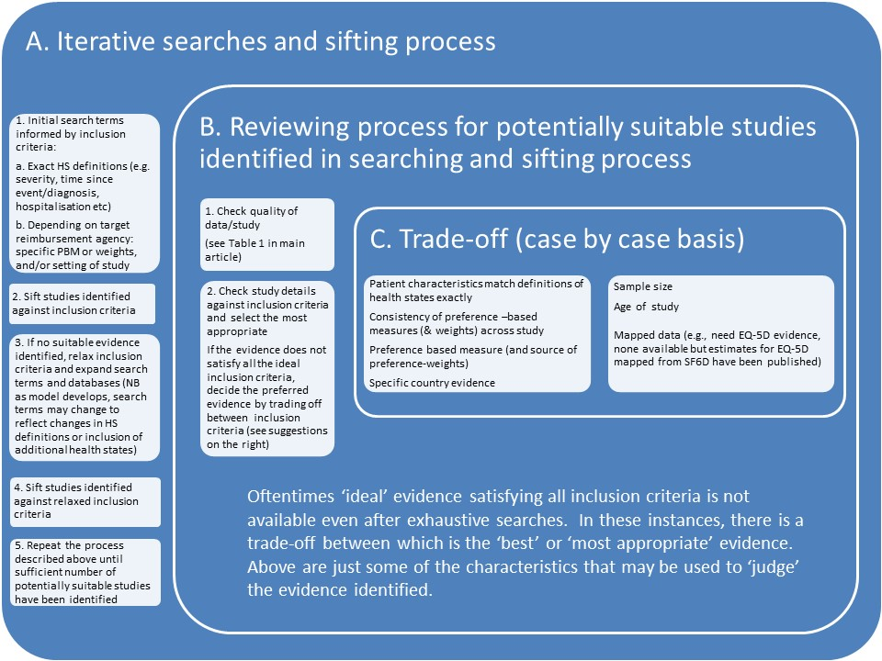
Often HSU identification and selection is not a straightforward process.
Notes:
Awkward phrasing. Fixed. Would be good to do a one page handout on this. Impossible to read.

Slide 13
Searching
Wide range of sources may be appropriate
  Clinical trials
  Observational studies
  Registries
  Surveys
  Previous economic evaluations
Methods must accommodate
  Needs of the model
  Needs of the decision maker

Slide 14
Model development
Model development often proceeds in an iterative fashion.
Searching & identifying utilities is similar, the scope may change as model develops
  Modeller and information specialist must work together closely.
Initial focused searches may be broadened in later iterations.

Slide 15
Scope of searches
Evidence relevant to a model
All health states and aspects of treatment and management that might impact on health-related quality of life (HRQL)
e.g. prophylactic treatments must include possible events in the future
Different to standard SR approach
  Standard SR approach Population – Intervention – Comparison – Outcomes (PICO)
  Focus here more constrained by model needs

Slide 16
Search scope
Searches should consider:
  Health state descriptions within the model
  Treatment effects of interventions and comparators of interest (treatment benefits and adverse effects)
  Treatment effects and management at all stages of the clinical pathway included in the model
  Carer utilities
  Comorbidities
  Concurrent clinical events/sequelae
  General population norms
  Moderators that might affect quality of life e.g., method of administration, treatment setting

Slide 17
Considerations when searching
Exhaustive searching for every parameter is not efficient.
Which states drive model results?
  Focus resources here
  Value of information (VOI) could inform when to stop searching*.
Transparency
  Not cherry picking
* ISPOR publishing 2 VOI Good Practices Task Force Reports in August issue of Value in Health.
Notes:
This is an FYI

Slide 18
Reviewing
Study population matches model?
Sample size/ response rates/ loss to follow up/ missing data
Proximity of data collection to event?
Appropriateness of the measure (e.g. EQ-5D etc)
Any evidence that the measure is inappropriate for disease area?

Slide 19
Selection
Standardisation
  Same measure used for all states in a model.
  May be better to prefer a source study that describes more of the required health states.
  But maintain minimum standards
May require a trade off between different issues
Selection rationale must be documented.

Slide 20
Synthesis of Health State Utilities
SECTION
2
Bruce Crawford, MA, MPH
Syneos Health

Slide 21
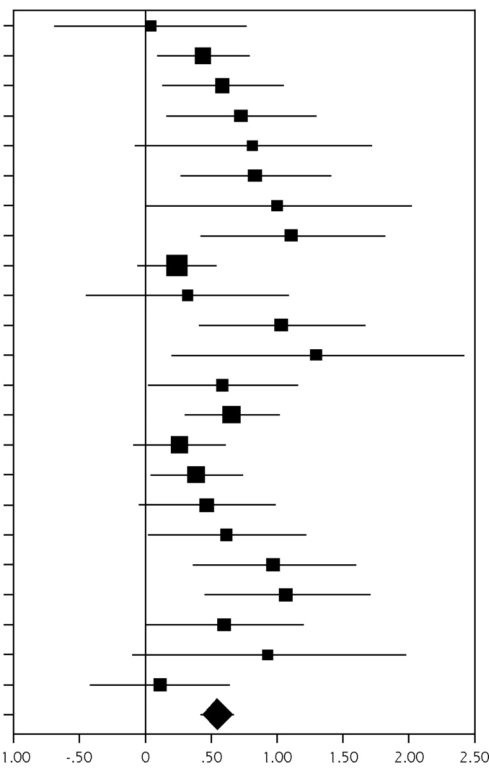
Why undertake synthesis?
Often multiple published values for a given health state.
Want to use all available evidence
Synthesis should generate a more accurate estimate of the mean value and uncertainty and improve generalizability.

Slide 22
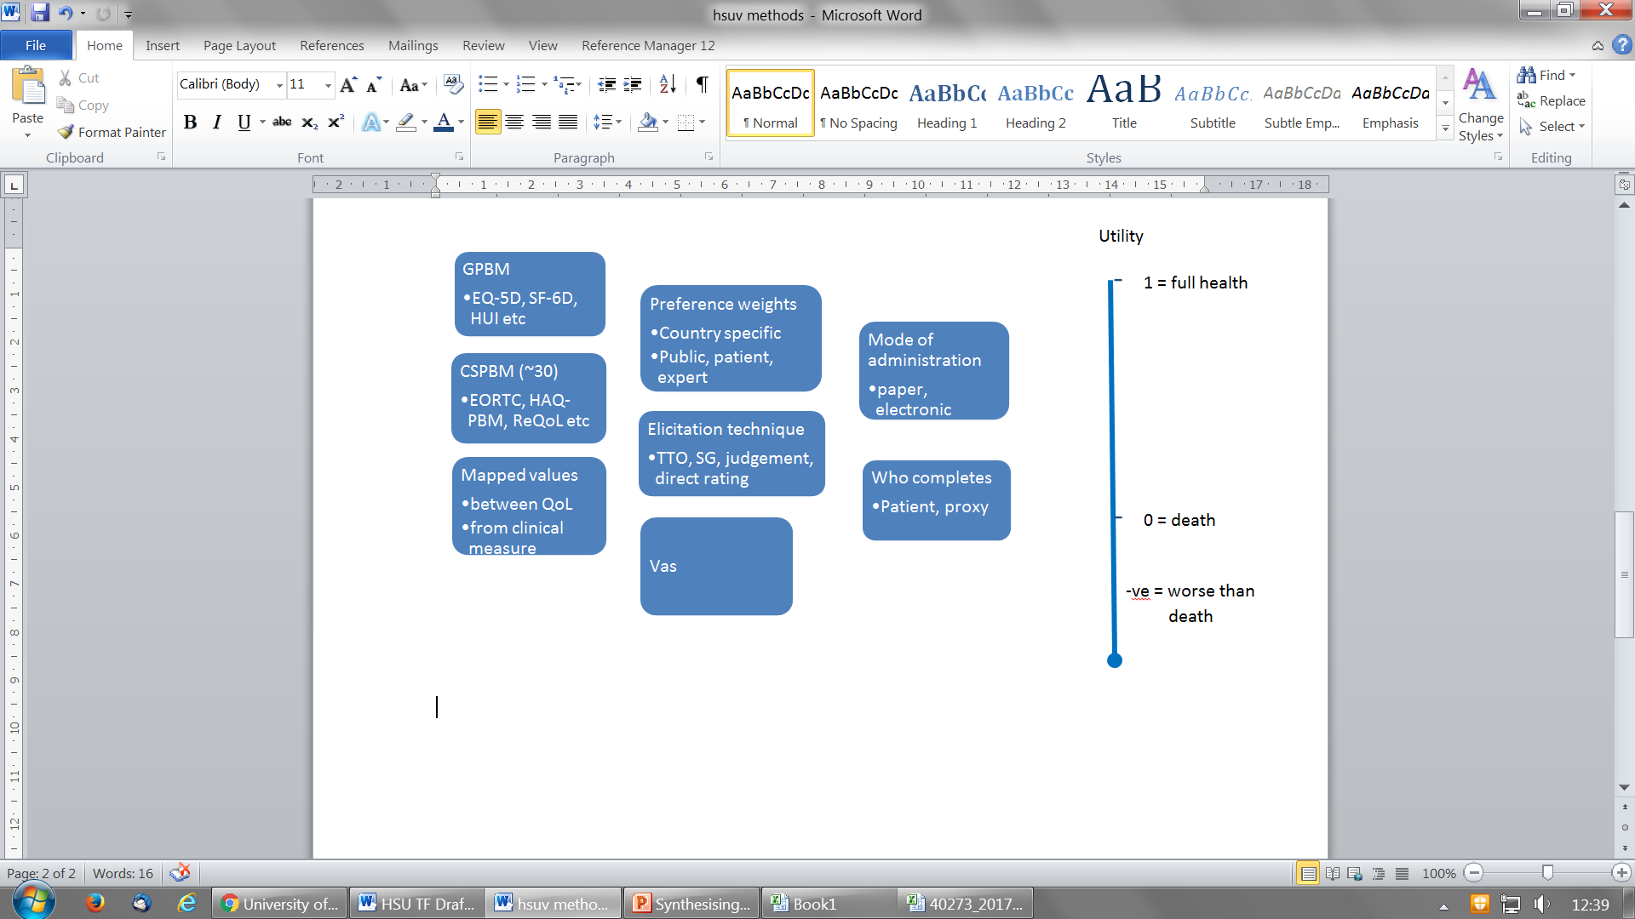
Measures and methods used to quantify utility
Notes:
. At least easier to read than the other. But could make boxes/ text bigger if not a picture.

Slide 23
Should we undertake HSU synthesis?
Difference in HSUs instruments / methods
General preference based measures / condition-specific preference based measures
Techniques used to elicit weights differ
Mode of collection may differ
Who completes the questionnaires – proxy, patient, general public, clinician
Preference weights
Statistical techniques

Slide 24
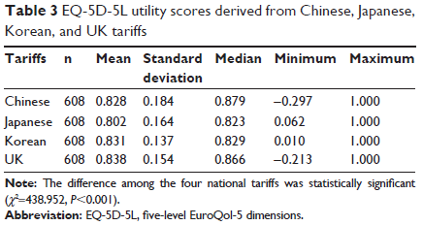
EQ-5D-5L differences by country value set
Different value sets on the same data produce significantly different results.
Authors conclude that different country value sets are not interchangeable.
Liu et al. Patient Preference and Adherence 2017; 11: 1049-1056

Slide 25
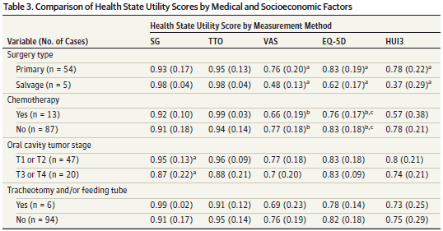
Different measures can produce vastly different results
0.07 vs 0.21 diff in utility
Noel et al. JAMA Otolaryngol Head Neck Surg 2015; 141(8): 696-703

Slide 26
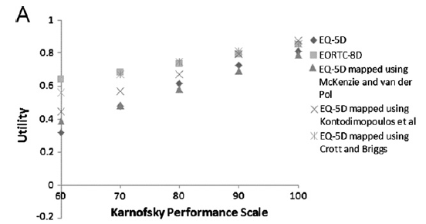
Different mapping methods produce varied utilities for the same performance level
Models may utilize functional levels such as HAQ DI levels of KPS levels, but the utility value assigned to that level can vary widely depending on the method used for utility
Rowen et al. ViH 2012; 15: 1059-1068

Slide 27
When undertake synthesis?
Are there enough HSU estimates?
Are studies sufficiently homogeneous?
Are they using the same HSUV measurement system?

Slide 28
Methods of synthesis of HSUs
Apply strict eligibility criteria to reduce heterogeneity
  Same measurement instrument used
  Same patient group (e.g., mild, moderate, severe depression;
  same KPS or HAQ-DI range)
Strict eligibility is useful, but considerable heterogeneity often remains.
Often there are not enough studies to restrict to a single measurement instrument.
Use meta-regression
  Limited to parameters reported in each manuscript
  It has been suggested that 10 studies per covariate should be used, but this is often not feasible.

Slide 29

Conclusions
Currently, formal synthesis is very limited for HSUs due to heterogeneity of valuation methods, country differences, population differences, etc.
Research still needed for methods of meta-regression in HSUV synthesis and when appropriate
When conducting synthesis:
  Limit to a single measure if possible; converting / mapping to a single measure may be useful, but be aware of the additional variance introduced.
  Carefully evaluate heterogeneity and model the impact if using meta-regression.
Notes:
2nd bullet delete “and”? when appropriate??? Is unclear.

Slide 30
Using Health State Utilities in Cost-effectiveness Models
SECTION
3
Prof John Brazier
University of Sheffield

Slide 31
Identifying the most appropriate health state utility (HSU) is just the beginning …………..
Issue | Recommendation
Sensitivity analysis (SA) | Always begin with SA
Discrete health states or discrete event simulation
Individual mean HSUs or function-based HSUs
Comorbidities & age
Concurrent clinical events or conditions
Treatment related adverse effects
Acute clinical events
Sensitivity analyses (again) | Always end with SA

Slide 32
Begin: sensitivity analysis
Look at the effect of each health state in model individually to inform level of literature searches.
Which HSUs influence the ICER?
Communicate with search/review team which HSUs really matter.

Slide 33
Model health states
Decide the format of the model in terms of numbers and types of health states that differ according to HSU
  Use clinical expertise & availability of evidence to inform decision
If simple model structure implemented that may not represent all important HSUs
  Examine & discuss expected effects of such omissions

Slide 34
Individual HSUs or function based:
Clinical events – acute? chronic? fluctuating? progressive?
Simple ‘acute’ events:
Bone fractures (e.g. hip, wrist, vertebrae)
CVD (e.g. MI, angina, stroke)
Less obvious in chronic progress conditions:
Arthritic conditions ‘flares’
Asthma exacerbations (hospitalised?)
Crohn’s disease
Age related macular degeneration
Consider:
Frequency of events
Severity of effect on QoL
Duration of time effect lasts
‘Rebound’ HSU after recovery
Timing of data collection matches acute period of event?
Explore likely effect if collection time does not match event
Notes:
Sometimes transparently clear that one can use mean HSUs as condition can be described using discrete time limited clinical events such as fractures in OP, or cardiac events in CVD
Other times less obvious whether to used mean HSUs or function. This is often in progressive conditions where effectiveness evidence from studies is in terms of a clinical variable that measures severity
Before decide discrete mean HSUs or a function, consider things on right
And the sample size available for HSU for different subgroups

Slide 35
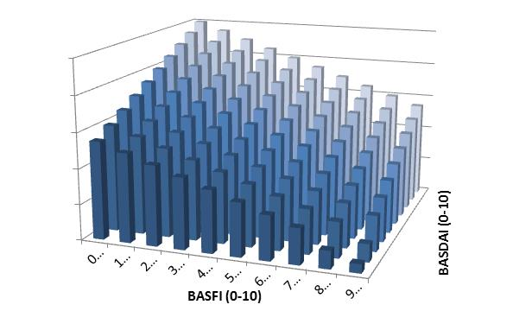
Discrete mean HSUs, or function based HSUs
Rheumatoid arthritis, measure clinical status using HAQ
Ankylosing Spondylitis, measure clinical status using both BASFI & BASDAI
A, Baseline HAQ=2.5, QoL=0.3, Start Tx1, HAQ & QoL improve
B, HAQ & QoL improve
C, HAQ progression on Tx1
D, Stop Tx1, HAQ rebounds
E, Start Tx2, HAQ & QoL improve
F, HAQ progression on Tx2
G, Stop Tx2, HAQ rebounds
AS: Both BASDAI & BASFI have strong relationship with utility.
3-D matrix, substantial sample size reqd. Use function to predict utility conditional on BASDAI & BASFI (plus age, gender ……. .
RA: HAQ strong relationship with utility.
Could use 3-30 discrete HS, depending on sample size for subgroups.
Notes:
Here have two examples where function is probably better than using mean values collected from subgroups
On left have RA, effectiveness measured using HAQ
Diagram shows how HAQ changes over time (patient responding to treatment, withdrawing from treatment HAQ reverts to baseline, getting a second treatment…..
HAQ has strong relationship with QoL
IF sample size sufficiently large, and have patients across the range of HAQ, then you could model this using evidence on QoL from subgroup (most use a function, but it could be done)
On right, Ankylosing spondylitis. Effectiveness measured using both Bath Ank Spond disease activity index and Bath Ank Spond Functional index. Range o-10. here would have a matrix for possible health states in model. Extremely unlikely sample size from trial would satisfy QoL subgrouping. Issue is underestimation of benefits of treatment if do not accurately reflect changes in QoL

Slide 36
Comorbidities, age & role of general population norms
(i.e. Baseline HSUs vary over model lifetime horizon)
Mean EQ-5D scores by age from HSE
Mean HSU is never equal to full health irrespective of measure, preference weights, age, condition or sample. Baseline of full health overestimates effects of avoiding events or conditions.
Notes:
Comorbidities increase by age and mean HSUs never = 1 ………..
On right, Dennis Fryback argued (1997) that not adjusting the baseline to account for reduction in QoL overestimates the benefit of treatment
Using full health the potential gain from avoiding condition is
Using gen pop norms the potential gain is
Many CE models use a lifetime horizon to accumulate QALYs, thus should adjust baseline to account for natural decline by age and increasing prevalence of comorbidities
(If get questioned double count – acknowledge small element of double counting, but if you take out a subgroup with a specific condition, unless huge prevalence, or huge effect on QoL, this is not going to make much difference on means for popn norms.
We have shown this in ViH 2011 and provide age adjusted by broad condition for EQ-5D
Fryback DG, Lawrence WG. Dollars may not buy as many QALYs as we think: A problem with defining quality of life adjustments. MDM 1997;17;276-284
Ara R, Brazier J. Using health state utility values from the general population to approximate baselines in decision analytic models when condition specific data are not available. ViH 2011;14(4):539-545

Slide 37
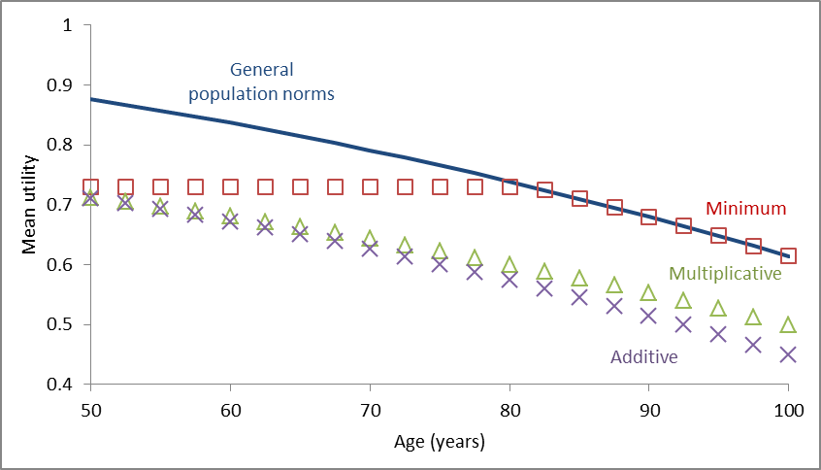
Combining HSUs when using age-adjusted baseline.
NB. For multiplicative DO NOT multiply HSUs together!
Estimate ‘multiplier’ = observed mean HSU / baseline mean HSU (at age of sample).
Notes:
When combingin HSUs people typically use one of three methods
Additive constant absolute, mutiplicative constant relative decrement.
Min ignores any additional decrement
Multiplicative – cannot just multiply utilities together as people often do
See our article ViH 2011 (don’t have time here to explain
But in summary (hypothetical numbers)
Have mean EQ of 0.7 at age of 74 for condition A
Gen popn norm at age 74 is 0.8
If multiply 0.7 by 0.8 you get 0.56
But you know you need 0.7 at age of 74 in model
so you lose the one piece of information you know is correct
If you multply together
You need to get the multiplier needed for this
Ara R, Brazier J. Populating an economic model with health state utility values: moving toward better practice. ViH 2011;13(5):509-518

Slide 38
Concurrent clinical events or conditions
Ideally collect evidence from persons of interest
Condition A
Mean HSU=0.7995
Condition B
Mean HSU=0.7304
Only have mean HSUs from samples with just one of conditions (condition A, or condition B).
Estimate the HSU for the concurrent health state using HSU from Condition A, and Condition B:
It is recommended that the multiplicative method is used.
Additive | =0.5903
Multiplicative | =0.6215
Minimum | =0.7304
Both Condition A
& Condition B
Mean HSU=0.6473
Notes:
Typically have mean values for people with individual conditions (comorbidities typically excluded from studies
If use these to estimate the HSU for the concurrent conditions (eg MI in someone with history of recent stroke)
Use the multiplicaive method - again don’t have time to go into details today
We have done several projects exploring this in different measures and samples
Every time multiplicative out performs other 2
Bias in errors in predicted and observed values for minimum and additive
Min underestimates true values
Additive overestimates true values
Multiplicative not perfect but much better than other two across full range
See our 2x articles or ref MDM review of all research & DSU TSD
Ara R, Wailoo AJ NICE DSU Technical Support Document 12: The use of health state utility values in decision models. 2011.
Ara R, Wailoo AJ. Estimating health state utility values for comorbid health conditions: a synopsis of the current evidence base. MDM, 2012.

Slide 39
Treatment related adverse events (AE)
CONSIDER:
Are AEs prevalent?
Do treatment related AEs have substantial effect on QoL?
  Check potential effect on ICER using SA in model.
Is effect captured in evidence used for HSUs in model?
  Those experiencing AE less likely to complete QoL measure.
  Take care not to double count effect if using trial data
What is likely duration of effect ?
  Chronic long term/ discrete short term & treatment withdrawal.
  TEST extreme values in model.
Notes:
Use fixed to “using” trial data

Slide 40
End: sensitivity analysis (again)
ALL HSU represented by parametric probability distributions.
Sample random values for PsA using Beta: rescale if –ve values possible
Consistency: for ordered values, sample using ’difference method’ ^{[Ren 2017]}
Univariate: Test which HSUs influence ICER using CIs.
Multi-variate: Test LCI & UCI that move ICER in same direction.
Notes:
Mutivariate misspelled
Step 1: Sample Y and X using Betas
Step 2: Transform sampled Y and X from step 1 to unbounded range
Step 3: Sample the difference between transformed Y and X
Step 4: Back transform
Ren S, Minton J, Whyte S, Latimer N & Stevenson M (2017) A New Approach for Sampling Ordered Parameters in Probabilistic Sensitivity Analysis. PharmacoEconomics. View this article in WRRO

Slide 41
Recommendations when using health state utilities in models
Issue | Recommendation
Sensitivity analysis | Use to determine which HSUs influence the ICER & report these analysis if applicable.
Discrete health states | Expected effects of excluding potentially relevant HSUs from a cost-effectiveness model structure should be examined & discussed.
Individual mean HSUs or function-based HSUs | Relevance of data (e.g. study population, utility measures, alignment with model’s health states) Reliability of analyses (e.g. precision of mean HSUs, validity of estimated utility functions) see Wailoo et al ISPOR TF
Comorbidities & age (baseline) | Mean HSU values represent comorbidity utility effects at the mean age of the utility study population. Age-specific comorbidity effects should be estimated using age-specific population norms.
Concurrent clinical events or conditions | The multiplicative method should be used to handle the utility effects of concurrent clinical events.
Treatment related adverse effects | Assess the extent utility effects of AEs are captured by the utility data used to estimate a model’s non-adverse event . If AE HSUs are required, the range of HSUs required should be informed by expected effect on ICER.
Acute clinical events | In the absence of data collected around the event, plausible HSUs for the direct effects of acute events should be multiplied by the expected duration to assess the sensitivity of ICER to these utility effects.
Sensitivity analyses (again) | One way & multi-way SA of HSU, Beta (scaled) distributions. Difference method to account for ordering in PsA.
Notes:
Handout??

Slide 42
Minimum Reporting Standards
The SpRUCE checklist
SECTION
4
Simon Pickard, PhD
Professor, University of Illinois at Chicago

Slide 43

Current approaches to reporting HSUs used in models
No literature review (too many hits, too much effort, no-one else does)
Use outdated evidence (or cite a value used in previous NICE submission)
Don’t cite original source (requires a detective to identify actual source:
3/4 iterations)
Don’t report actual values used (just cite any study & let reader find
them if they really want to)
Never, ever provide details of source study (e.g. patient characteristics, measure used, sample size etc.)
‘Tweak’ the values (several times)
Assume comparator has no benefit (equivalent to baseline of full health)
Ignore adverse events (or make something up, or use evidence from a different treatment)
Add clinical effects together when using two interventions, or ignore one (equivalent to using additive or minimum method to combine HSUs for concurrent events)
Combine effects measured using different units (e.g. SF-6D, HUI & EQ-5D within same model)
Don’t bother using the values in the report in the cost-effectiveness model
Notes:
Pose the question
How would peers, reviewers and policy makers react if the above were done for clinical evidence?
But much better to standardise practice
Current practice undermines the rational for cost per QALY
the results generated using different methods are NOT directly comparable.

Slide 44
HSU identification and selection is often not a straightforward process
  Challenges to being explicit
  Iterative search and sifting process

Slide 45

SpRUCE Checklist
Provides minimum reporting standards for the Systematic Review of Utilities for Cost-Effectiveness (SpRUCE checklist).
Criteria intended to help model reviewers identify if HSU selection for the model was transparent and appropriate.
A greater level of detail is likely needed to proceed to peer-reviewed publication of a systematic review.
      Five sections:
        search strategy
        review process
        data extracted from each study
        basis for obtaining the final HSU
        use in cost-effectiveness models

Slide 46
SpRUCE Checklist: Search Strategy
Search Strategy
Search terms and scope | The final search strategy should be adequately defined and appropriate databases included in the search.
Study selection criteria | Explicit criteria for study identification/inclusion should be described and applied, such as patient group of interest, relevant age range and stage of disease/severity etc.

Slide 47
SpRUCE Checklist – Review Process
Review Process
Quality check | Quality criteria for reviewing studies explicitly stated and applied.
Assessment of relevance | Relevance of HSUs to model and target reimbursement agency described.

Slide 48
SpRUCE Checklist: Key Data Extraction
Data Extracted (reporting of variables)
Population/patient characteristics | Relevant patient characteristics (e.g. age, sex, comorbidities, diagnosis, severity of condition).
Measure used to describe the HSUs | The measure used to obtain the HSUs.
Valuation technique for preference weights | The technique used to value the heath state (e.g. TTO, SG), and the country (provide reference).
Descriptive statistics of HSUs | The mean and variance around any HSU used in the model.
Response rates to the measure used* | Report if response rates are likely to be a threat to validity.
Loss to follow-up/ missing data* | Loss to follow-up (e.g. 1 year after fracture) and missing data should be reported, especially if they may threaten the representativeness of the HSUs.
Original reference | The original source for the HSUs should be referenced (not a previous economic study that has used the evidence).

Slide 49
SpRUCE Checklist
Selection/estimation of final health state value
Basis for selecting HSUs | The rationale for selecting the HSUs used in the model should be justified.
Method used to combine estimates | Where HSUs are combined, the analytic methods should be described e.g. meta-analysis.

Slide 50
SpRUCE Checklist
Methods used when applying the health state utilities in model
Actual HSUs used | Report all actual HSUs used in the model together with associated measure.
Adjustments or assumptions | Clearly describe any adjustments or assumptions relating to the use of HSUs in the model, reporting both the raw and final values used with worked examples if required to clarify the method used to adjust the data.

Slide 51

Slides are available on the ISPOR 2018 Baltimore webpage https://www.ispor.org/Event/index/2018Baltimore

Slide 52
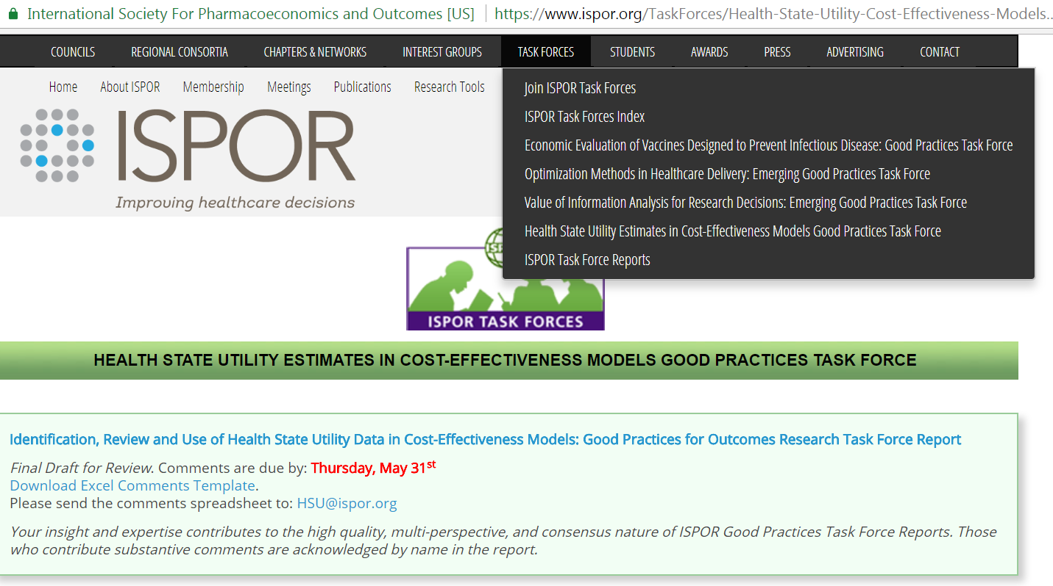
Please JOIN our review group!
Being a member will keep you abreast of ISPOR HSU activities, too!

Slide 53

Task Force’s Final Draft Report is available on our webpage for comment:

Slide 54

Discussion
Did you know?
John Brazier is a vegetarian, but he has yet to introduce spruce into his daily diet

Slide 55
References
Fryback DG, Lawrence WG. Dollars may not buy as many QALYs as we think: A problem with defining quality of life adjustments. MDM 1997;17;276-284
Ara R, Brazier J. Using health state utility values from the general population to approximate baselines in decision analytic models when condition specific data are not available. ViH 2011;14(4):539-545
Ara R, Brazier J. Populating an economic model with health state utility values: moving toward better practice. ViH 2011;13(5):509-518
Ara R, Wailoo AJ NICE DSU Technical Support Document 12: The use of health state utility values in decision models. 2011.
Ara R, Wailoo AJ. Estimating health state utility values for comorbid health conditions: a synopsis of the current evidence base. MDM, 2012.
Ren S, Minton J, Whyte S, Latimer N & Stevenson M (2017) A New Approach for Sampling Ordered Parameters in Probabilistic Sensitivity Analysis. PharmacoEconomics. View this article in WRRO

