Slide 1
ISPOR New Professional Webinar:
Career Advice Across the Globe
“Unfortunately this Content is Unavailable in Your Region: What is the Impact of General Data Protection Regulation (GDPR) on the HEOR Community?”
DATE
TIME

Slide 2
Overview of Agenda
Time | Topic | Presenter
 | Welcome | Jason Cohen, MPP
 | Objectives, Overview of agenda | Dr. Elisabeth Oehrlein
 | Speaker: Berit Faber | Dr. Berit Faber
 | Speaker: Carl Asche | Dr. Carl Asche
 | Speaker: Jacco Keja | Dr. Jacco Keja
 | Q&A / Open Discussion | ALL

Slide 3

Objectives & Overview
This session will introduce New Professionals and graduating students to the European Union’s General Data Protection Regulation (GDPR) and explore how it might impact outcomes researchers.
The topic was selected through ISPOR Staff’s collaboration with the New Professional Steering Committee members.
Upon completion of the presentations there will be time for Q&A
Notes:
HTA was identified as one of the topics of interest from the results of the most recent New Professional Interest Survey.

Slide 4
ISPOR New Professionals Overview
Presenter:
Elisabeth Oehrlein, PhD, MS
Senior Director, Research and Programs,
National Health Council
Washington, DC, USA &
ISPOR New Professional Steering Committee Chair

Slide 5

New Professional Overview
The ISPOR New Professionals Network is composed of recent graduates from HEOR related programs. The membership is available to former ISPOR student members and any new members who join that possess 3 years or less of experience in the HEOR field.
Members will be eligible to renew for two additional years after they join before becoming standard ISPOR members. Current ISPOR members, paying the $150 Standard membership, are not eligible to downgrade their membership to New Professional.

Slide 6






New Professional Steering Committee
New Professional Steering Committee Chair:
Elisabeth Oehrlein, MS, PhD, Senior Director, Research and Programs, National Health Council, Washington, DC, USA
New Professional Steering Committee Members:
Blythe Adamson, MPH, PhD, Senior Quantitative Scientist, Flatiron Health, New York, NY, USA
Sanket Shah, PhD, MD, Manager, Stratevi, Boston, MA, USA
Ernest Law, RPh, PhD, Senior Manager, Pfizer Inc., New York, NY, USA
Mark Bounthavong, MPH, PharmD, Investigator, Veterans Affairs Health Economics Resource Center, Menlo Park, CA, USA
ISPOR Staff:
Jason A. Cohen, MPP, Manager, Member Services (Students & New Professionals), ISPOR, Lawrenceville, NJ, USA
Elisabeth
Blythe
Sanket
Ernest
Mark
Jason

Slide 7
Member Benefits Overview
Resources
ISPOR Value & Outcomes Spotlight, the news journal of the Society;
Electronic version of Value in Health, the peer-reviewed journal of the Society;
Access to online educational opportunities including: “My Career Path” webinars, “My ISPOR Story” webinars, scientific webinars, and thought leadership videos;
ISPOR Career Center;
At ISPOR Meetings
Events during ISPOR conferences;
Networking opportunities
Access to the
Eligible to participate in special interest groups / task forces;
Special Benefits
Eligible to apply for ISPOR Meeting Travel Grants;
Free online access to FormularyDecisions.com;
Email newprofessionals@ispor.org with questions or suggestions on how we can improve the member experience!

Slide 8

In-Person Events
Reach out to a Steering Committee member if you’re in town. We’re in:
  Boston, New York, San Francisco, Washington DC

Slide 9
Introduction to Today’s Topic

Slide 10
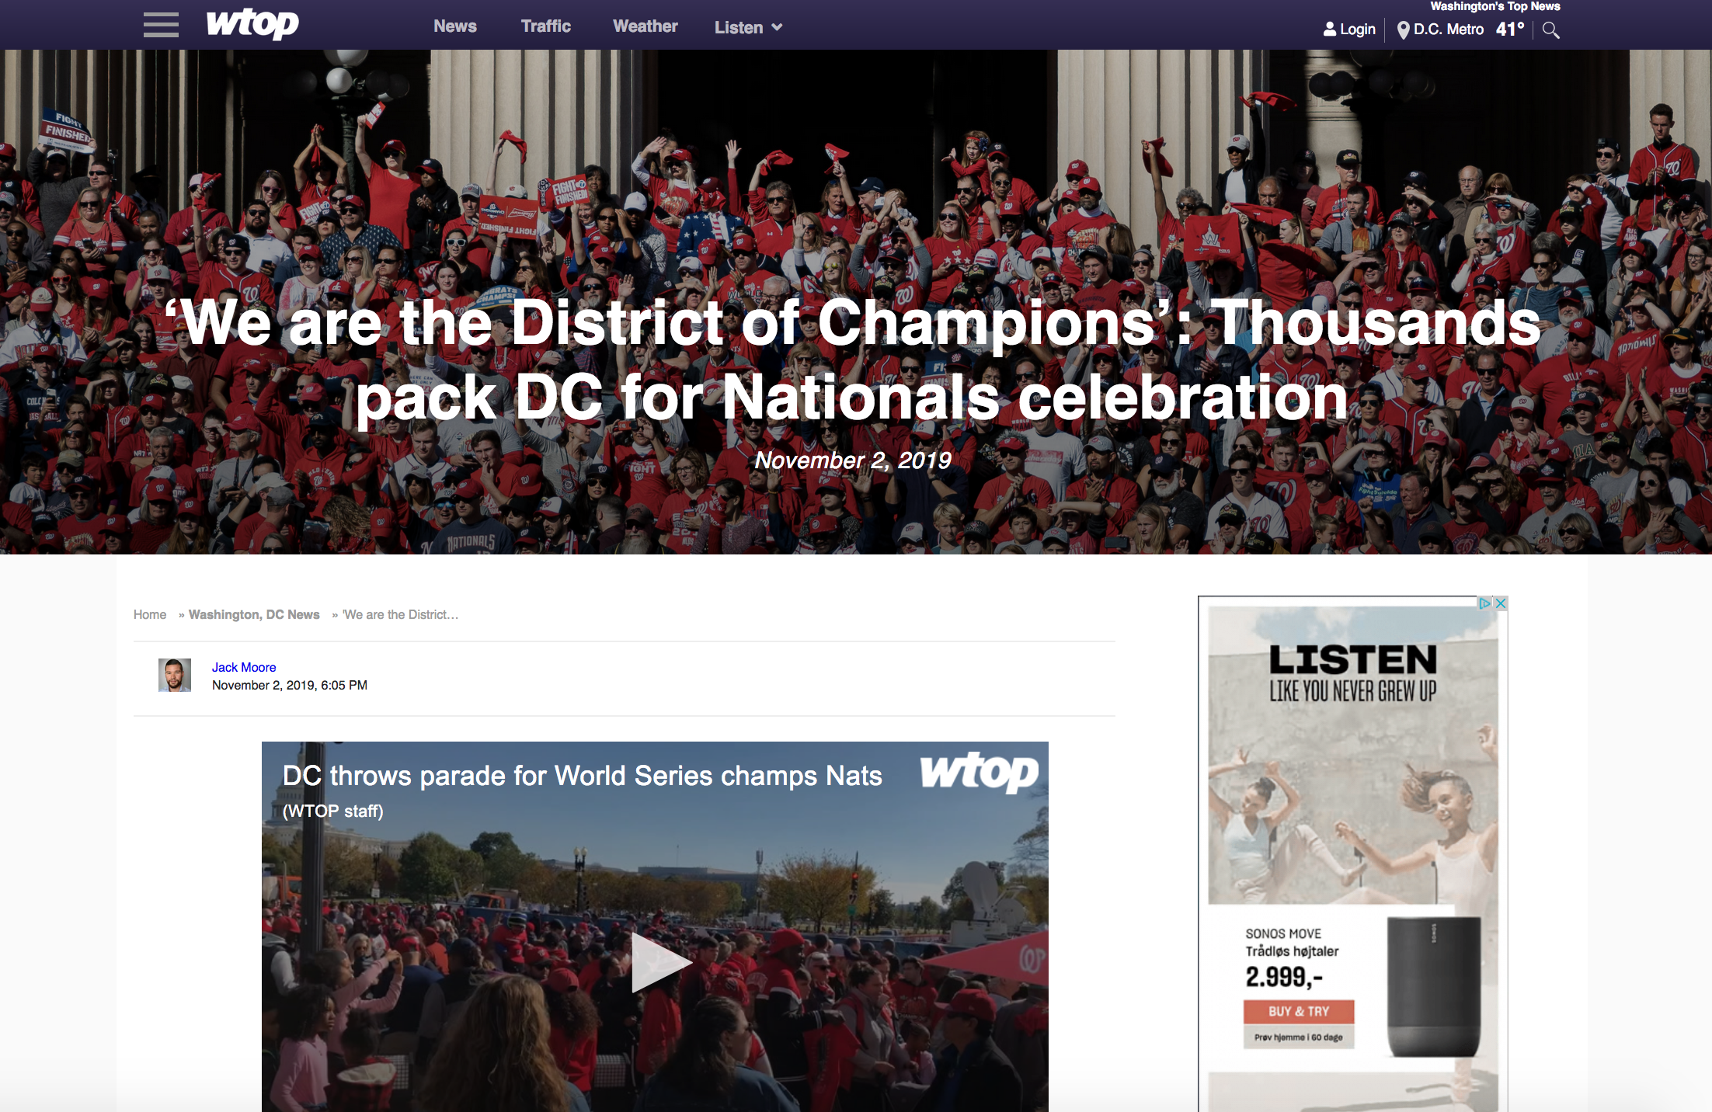


Slide 11
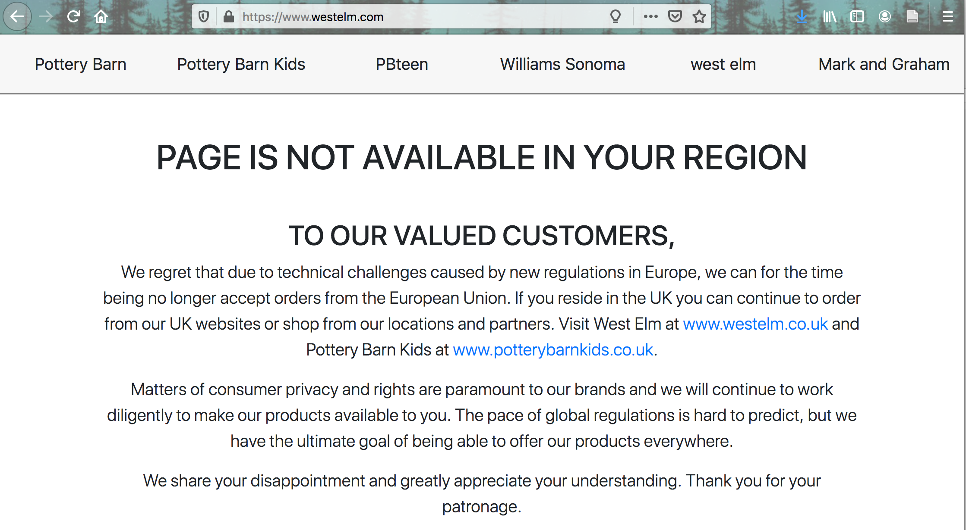

Slide 12
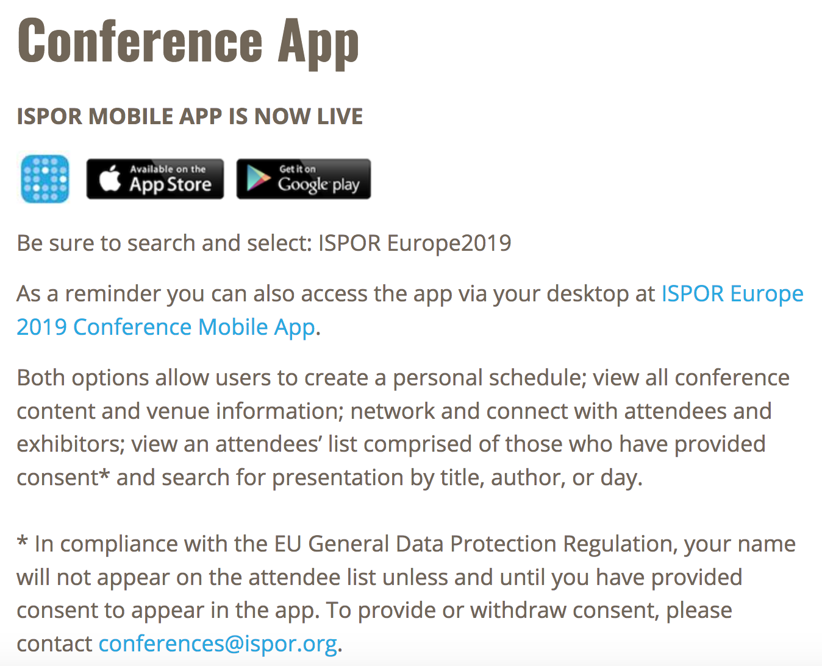
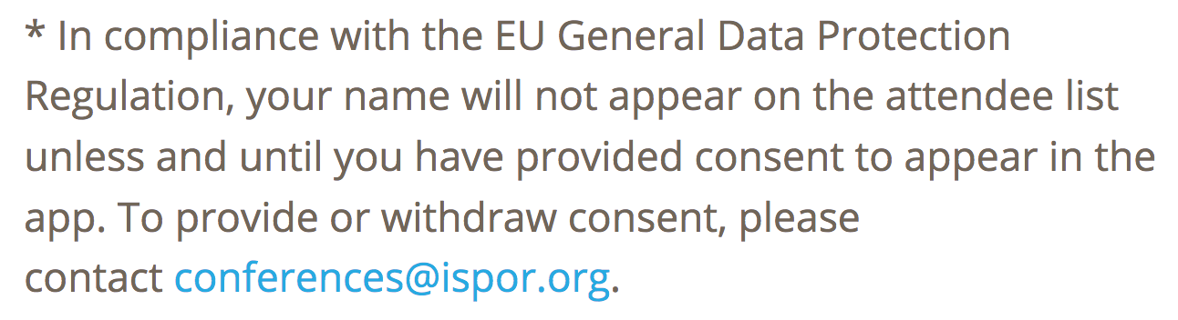

Slide 13
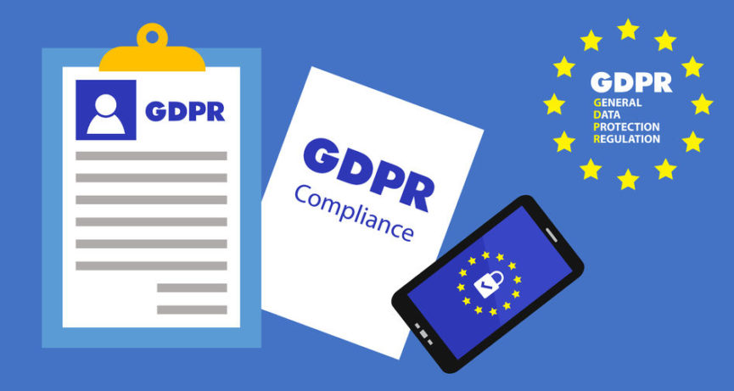
What is GDPR? Where did it come from? How might it impact researchers?
Image from: https://blog.finjan.com/gdpr-social-media-marketing/

Slide 14
Speakers
Berit Faber, LLM, Jurfast Project, Southern University of Denmark
Carl Asche, PhD, Director of the Center for Outcomes Research at the University of Illinois College of Medicine at Peoria
Jacco Keja, PhD, Vice President, Real-World Evidence Solutions, Global IQVIA

Slide 15
ISPOR New Professional Event:
Career Advice Across the Globe
“Unfortunately this Content is Unavailable in Your Region: What is the Impact of General Data Protection Regulation (GDPR) on the HEOR Community?”
Presenter:
Berit A. Faber, LLM
JURFAST Project
University of Southern Denmark (SDU)
berit @ faber.net

Slide 16
BioLAW
Setting the Scene
BioGOVERNANCE
Data-protection - GDPR
Research Participants
Data subjects?
Society?
Future Generations?
Health-research based
on Personal
Data?
BioDEMOCRACY ?
BioECONOMY
BioETHICS
From BioETHICS to BioLAW?
From DataLAW to DataETHICS?
Research in Health Data: Contacts Innovation, Patents)

Slide 17

Transparency
“The new biotechnologies within healthcare and medicine make the patient transparent to the system
We need to make the system transparent to the patients”
Prof. Mette Hartlev

Slide 18
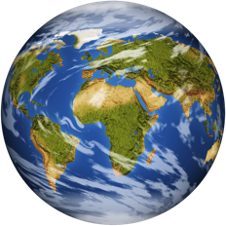
Consent: Legal models tackling different scenarios
The Donor as a mining-area:
No restrictions/obligations towards donors and society
Researcher-heaven Pharma-heaven?
Laissez Faire – Opt out?
Donors are conscious drivers of the process
Patients’ organisations
Opt in – layered consent, dynamic consent? Right to know Right not to know? Incidental findings? The right to know and the right not to know? Economic benefits?
Notes:
Contractual obligations between research participant/data subject - researcher?
Paternalistic obligations?
Models of trust?
New models of taking care of the Personal Data in research projects?
New models of empowering the research participant/ data subject?

Slide 19
How to combine the areas of protection
in Biolaw and Data-protection:
Bioethics – data ethics?
The donor seen as a research project participant:
Human Rights, Bioethics Convention
Helsinki Declaration
EU regulation on medicinal trials
National regulation on research ethics
The donor seen as a data subject:
EU Regulation no. 679/2016 General Data Protection Regulation
https://eur-lex.europa.eu/legal-content/EN/TXT/?uri=CELEX:32016R0679
National supplementary legislation

Slide 20
Regulation (EU) 2016/679
Article 4: Definitions: 26 definitions of concepts used in GDPR
Personal data (1), processing (2) pseudonymization (5) controller (7), consent (11) Genetic Data (13) Biometric Data (14), “Data concerning Health” (15) Cross-border processing (23)
Article 5: Principles relating to processing of personal data
b)collected for specified, explicit and legitimate purposes and not further processed in a manner that is incompatible with those purposes; further processing for archiving purposes in the public interest, scientific or historical research purposes or statistical purposes shall, in accordance with Article 89 (1), not be considered to be incompatible with the initial purpose
e) Storage Limitation: Personal data may be stored for longer periods than necessary for the purposes for which the personal data is processed.

Slide 21


Pitfalls: Anonymization - Pseudonymization
Anonymization
No Re-identification:
The link between the
Data-subject and the data is
Irrevocably broken
Pseudonymization
Re-identification is possible:
The link between the
Data-subject and the data
can be re-created

Slide 22
Important Contractual Caveats in relation to Personal Data and research collaborations
The Research Collaboration Contract Phase:
Elements of Legal Basis for the Contract:
Legal basis for research? ( i.e. Ethics Approval)
Legal basis for handling personal data in the project?
Legal basis for Transfers to unsafe 3. countries?
Elements of legal basis and data safety: Consent, Data Management Plan, Dataflow in the project ? ? ? ?
The Innovation Phase:
Can governance and data safety play a role/pose restrictions in the Innovation phase ? ? ? ?

Slide 23
ISPOR New Professional Event:
Career Advice Across the Globe
“Unfortunately this Content is Unavailable in Your Region: What is the Impact of General Data Protection Regulation (GDPR) on the HEOR Community?”
Presenter:
Carl Asche, PhD
Professor & Director, Center for Outcomes Research
University of Illinois, Chicago
Chicago, IL, USA

Slide 24
ISSUE
Healthcare systems stakeholders are looking to reduce inefficiencies, remove redundancies, personalize treatments, improve healthcare quality, and patient access, whilst trying to reduce healthcare costs.
As of May 2018, European patients are protected by General Data Protection Regulation (GDPR).
Notes:
Healthcare systems stakeholders are looking to reduce inefficiencies, remove redundancies, personalize treatments, improve healthcare quality, and patient access, whilst trying to reduce healthcare costs.
As of May 2018, European patients are protected by General Data Protection Regulation (GDPR), which entitles patient with the right to delete their full personal medical record. Other geographic regions are following GDPR closely and may follow the European lead.

Slide 25
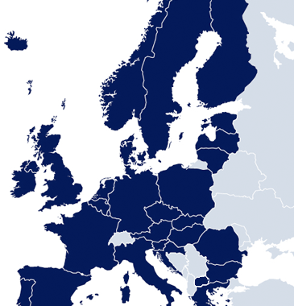
BACKGROUND
General Data Protection Regulation (GDPR) .
GDPR will be directly applicable in all EU Member States.
Notes:
General Data Protection Regulation (GDPR) is the first comprehensive overhaul of European Union data protection rules in 20 years - it repeals and replaces Directive 95/46/EC
GDPR is directly applicable in all EU Member States, adopted in EEA, and will replace existing national law implementations of the Directive

Slide 26
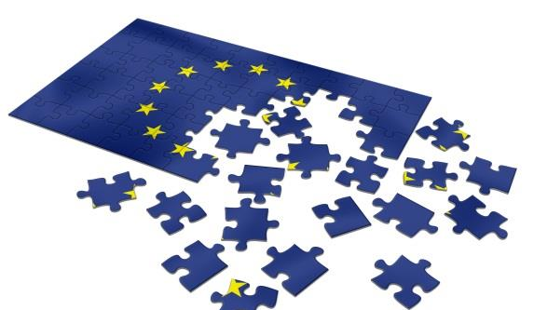
GDPR FEATURES
Worldwide territorial scope.
Enhancements.
One-stop shop.
Sanctions.
Notes:
Worldwide territorial scope: GDPR applies to data controllers that process the personal data of EU residents, regardless of location
Enhanced rights, additional obligations: new rules on consent, access rights, profiling, impact assessments, data transfers, and much more
One-stop shop: lead authority model, multilateral approach to transnational cases, new European Data Protection Board
Enhanced sanctions: maximum fine levels likely to be between 2% and 5% of global turnover

Slide 27
WAYS BY WHICH GDPR WILL AFFECT THE HEALTHCARE INDUSTRY

Slide 28
SAFER PERSONAL DATA
The GDPR mandates that data breaches must be reported.
Concern that GDPR will severely impact ability to engage with customers and prospects.
GDPR presents a great opportunity to build trust.
Notes:
The GDPR mandates that data breaches must be reported within 72 hours. Naturally, this will drive healthcare professionals and organizations to take better care of the data they hold and, of course, the higher fines in play will act as another incentive to dramatically improve data security.“
Many companies are concerned that GDPR will severely impact their ability to engage with customers and prospects, owing to the new restrictions on right to erasure, right to be informed and right to object.
However, given the backdrop of hackers, data breaches from multiple household names and concern about how social media companies use our personal information, GDPR presents a great opportunity to reset relationships and build trust between companies, staff and customers or patients.

Slide 29
DETAILED PATIENT PROFILES
The data footprint of an individual is usually highly fragmented.
Healthcare providers will have a more detailed view.
GDPR enshrines the right to be forgotten, which could emerge as a barrier to improved diagnosis.
Legal requirement for all healthcare providers to retain records for a prescribed period in case of query.
The GDPR places a framework around this data.
Notes:
With data collected at points ranging from doctor’s surgeries to specialized healthcare organizations, the data footprint of an individual is usually highly fragmented.
One of the core components of the GDPR is ensuring that there’s more available information about the purpose and location of any data that’s collected. This means healthcare providers will have a more detailed view of their patients, which could lead to better and more accurate diagnosis, as well as more targeted treatments at lower cost.
The counterpoint, though is that the GDPR enshrines the right to be forgotten, which could emerge as a barrier to improved diagnosis.
“It is a legal requirement for all healthcare providers to retain records for a prescribed period in case of query. This will need to be tracked closely to both ensure the record is not disposed of prematurely or the subject is denied a disposal when it is valid to do so.”
Mandating that patient data has more structure could be hugely beneficial to HCPs. The GDPR places a framework around how this data can be collected, used and in which scenarios it must be deleted, but individual patient care should benefit from reduced fragmentation.

Slide 30
PUTTING PATIENTS IN CONTROL
Healthcare is the one area of our lives that has remained highly sensitive and private.
Some of the new data-subject rights also help customers feel in control.
The framework is there to give the user control; but how?
Notes:
Healthcare is the one area of our lives that has remained highly sensitive and private. But test results are often shared widely to reach a diagnosis, with the patient having little insight into how this information is collected, who has access to it and how it is stored. GDPR places individuals firmly in charge of their data.
“Some of the new data-subject rights also help customers feel in control – for example, they have stronger rights to stop how their data is to be used if they change their mind about consent. Demonstrating that you have thought about how you use data and have put appropriate protection in place can definitely help, even where the customer has no choice.”
“The framework is there to give the user control but how? How are people going to be educated? How will this be facilitated? GDPR goes part of the way in definition but there is no easy way for the individual to control their data. In short the potential is there but how successful it will be is yet to be seen.

Slide 31
USING NEW DATA SOURCES
Research has found that healthcare is the industry the general public most trusts with its personal data.
Technologies from social networking are increasingly being used to deliver patient care and support.
Notes:
According to Future Health Index data, research found that healthcare is the industry the general public most trusts with its personal data. There is, therefore, a strong foundation from which to make health data collection part of more peoples’ lives.
On the HCP side, technologies from social networking are increasingly being used to deliver patient care and support. Healthcare professionals regularly use networks such as Whatsapp to send patient data to each other. As this information moves across the network, this could mean sensitive data is held outside of the EU, breaching GDPR regulations.

Slide 32
FROM DATA INSIGHTS TO BETTER PREVENTION
The success of ERNs also depends on big data.
The masses of data that healthcare organizations have been collecting for decades is still often unstructured and inaccessible.
The GDPR is a reason for the health sector to be excited.
Notes:
Speaking at the ‘Big data: Connected solutions for better healthcare’ conference held in Brussels last year, EU health commissioner Vytenis Andriukaitis referred to the European Reference Networks (ERNs) that aim to promote cross-border healthcare: “The success of ERNs also depends on big data: they will compile fragmented health data sets, generate new clinical, genetic, behavioural and environmental data, and make use of these data.”
The masses of data that healthcare organizations have been collecting for decades is still often unstructured and inaccessible. The ideas behind big data and how it can unlock the insights contained with healthcare information is a major reason why GDPR could offer the healthcare industry a huge opportunity. The insights that come from the drive to structure and integrate data could accelerate new therapies and bolster moves to improve prevention.
Overall, the GDPR is a reason for the health sector to be excited – it could help unlock the potential in huge stores of data that have remained dormant for decades.

Slide 33
GDPR INTRODUCES IMPROVEMENTS
Clear language
Consent from the user
More transparency
Stronger rights
Stronger enforcement

Slide 34
GDPR (excerpts from factsheet)

Slide 35
GDPR (excerpts from factsheet) (2)

Slide 36
GDPR (excerpts from factsheet) (3)

Slide 37
BEWARE THE DOWNSIDE OF GDPR
A couple of potential issues:
The GDPR may frighten organizations into being very careful about what data they collect and share. Will they be too conservative? Will it lead to less innovation?
GDPR gives individuals with the ‘right to be forgotten’.
If many individuals exercise this right, this can reduce our ability to obtain valid and precise estimates of the effectiveness and cost-effectiveness of many different types of healthcare interventions.

Slide 38
ACCOUNTABILITY PRINCIPLE
Because of the “accountability principle”, some organizations may be very conservative and not quick to share data with other parties.
At the very least, researchers may need more time to acquire data and this will lead to delays in important discoveries.

Slide 39
RIGHT TO BE FORGOTTEN
The right to request erasure of personal data (“the right to be forgotten”) (Article 17) could lead to databases with fewer individuals.
This may not lead to problems when researching the causes and treatment of common diseases, but it could lead to problems with researching uncommon subtypes or diseases.
A database with fewer individuals will mean a reduced ability to:
  Identify causes of disease
  Estimate the effectiveness of a treatment
  Estimate the prognostic/predictive value of biomarkers
  Etc.

Slide 40
RIGHT TO BE FORGOTTEN: BIASED
If the persons who request erasure of personal data are different from others in “important” ways, this will result in biased results and conclusions.
That is, these people may differ in:
  their disease risk
  the safety or effectiveness of a treatment
  the prognostic/predictive value of a biomarker
  etc
Therefore, results based on these people will not generalizable to all people!
Statistical adjustment may not correct this problem sufficiently.

Slide 41
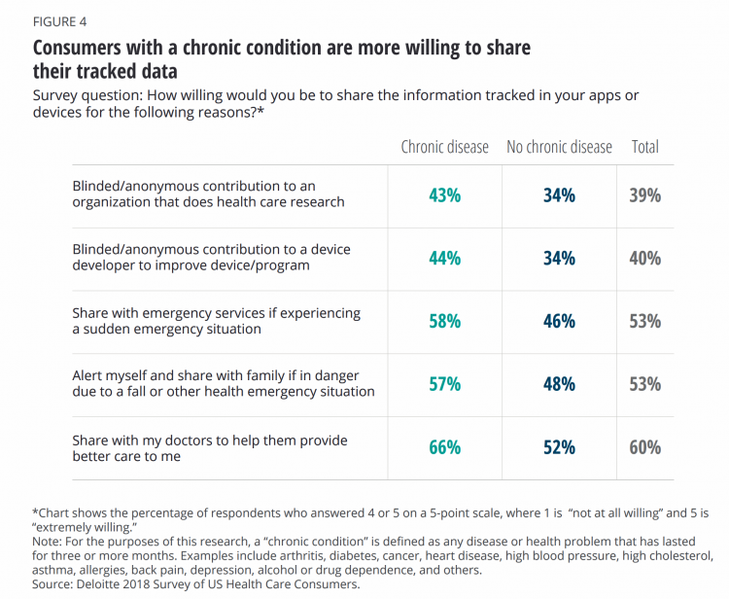
WILLINGNESS TO SHARE (U.S.)?
Notes:
Source: https://www.healthpopuli.com/2018/09/27/sicker-consumers-are-more-willing-to-share-tracked-health-data/
Three points:
1. I can’t judge the veracity of the findings, but its face validity is good.
2. People with a chronic condition are more often willing to share their data than others, though the diffs aren’t big.
3. While people with a chronic condition are more likely to be willing to share their data, that percentage is nowhere near 100%, not even if their own health can be improved!
4. Look at the last line: many people are NOT willing to share data with their own doctor even when the aim is to get better care!!!!!!

Slide 42
SIMILAR SITUATIONS IN HEALTHCARE
If we conclude that policies like GDPR may severely affect healthcare research and healthcare, how can we convince people that it is better for them (and others) not to be forgotten?
Can we learn from the experiences in other areas of healthcare?

Slide 43
EXAMPLE 1: ORGAN DONATION
Some people choose not to register to donate their organs after they die; plus family members refuse it
This reduces the number of available organs, which increases waiting time for an organ
Result: poorer health and/or an earlier death
Question: what can be done?
Policy options include:
  Require everyone to donate their organs
  Give donor refusers a lower priority for organs
  Do not give donor refusers any organ
  Provide incentives
  Provide better health education

Slide 44
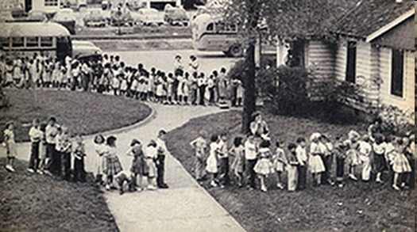
EXAMPLE 2: VACCINATIONS
Some people refuse to have their child vaccinated.
Consequence: Their children’s risk will increase
  - This will also reduce overall coverage, thereby reducing herd immunity and increasing the risk of disease in other children.
Question: what can be done?
Policy options:
  Mandatory vaccination
  Incentives/disincentives for vaccinations (e.g., ineligibility for other benefits)
  Better health education
Notes:
Picture: Segregated lines for Salk polio vaccine (1944)
Policy options:
Mandatory vaccination
Incentives/disincentives to promote vaccinations (e.g., make refusers ineligible for other societal benefits)
Better health education

Slide 45
MESSAGES
GDPR may be a way forward from a societal standpoint but it could hamper advances in health.
If you exercise your right to privacy, you may reduce your own future health (as well as the health of others).
We will need ways to encourage people not to be forgotten.
Organisations need to gain the trust of others.
We need to apply incentives/disincentives to discourage people from opting out (ethically)

Slide 46
ISPOR New Professional Event:
Career Advice Across the Globe
“Unfortunately this Content is Unavailable in Your Region: What is the Impact of General Data Protection Regulation (GDPR) on the HEOR Community?”
Presenter:
Jacco Keja
IQVIA
VP consulting services RWE HEOR
London, UK

Slide 47
“Unfortunately this Content is Unavailable in Your Region”
What is the Impact of General Data Protection Regulation (GDPR) on the HEOR Community?
Jacco Keja VP consulting services RWE HEOR

Slide 48
Disclaimer
My presentation is a personal view and does not represent that of my employer
Please note that this presentation does not constitute legal advice

Slide 49
Defined

Slide 50
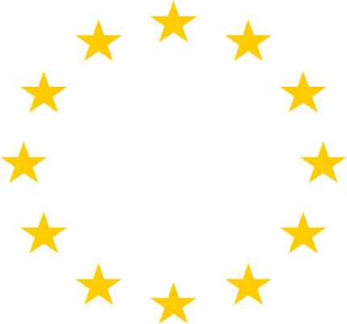
EU DATA PROTECTION LANDSCAPE
Other legislation to be considered as part of the EU Data Protection Framework
Until 25 May 2018
After 25 May 2018
EU Data Protection Directive
(95/46/EC)
EU General Data Protection Regulation (GDPR)
e-Privacy Directive
  Complements the Data Protection Directive / GDPR
  Applies to electronic communication services
  Will be replaced by the e-Privacy Regulation (2019)
Directive on security of network and information systems (NIS Directive)
  EU-wide rules on cybersecurity with the objective to achieve a high common level of security of network and information systems within the EU
  Transposition to national laws until 10 May 2018
Transposed into local
Data Protection Act
in each EU Member State
+
Different local regulations but same framework
One single regulation for all the EU Member States – directly applicable, without the need to be transposed
+
Local derogations are possible – captured under national laws

Slide 51
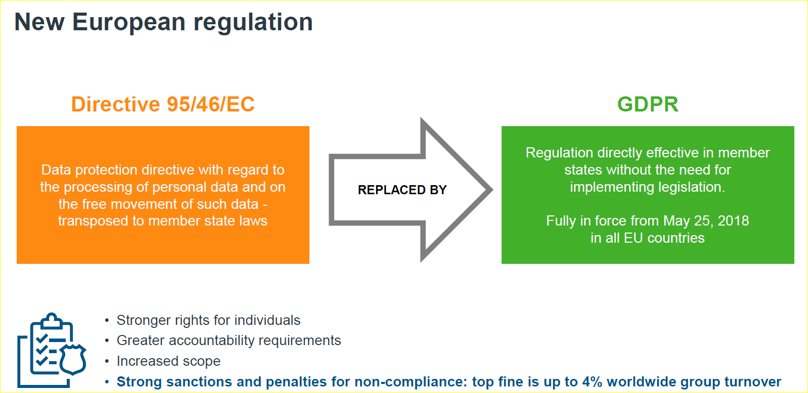
What is the GDPR (General Data Protection Regulation)?
It sets new standards for the collection, use,
processing and transfer of the personally identifiable information of EuropeanUnion citizens.

Slide 52
What is the objective of GDPR?
General Data Protection Regulation provides a single set of rules for data protection across Europe.
GDPR seeks to expand the rights of individuals over how organizations use their personal data and to bring data protection law in line with how people’s data is being used.
EU’s desire to making data protection law identical throughout member states to give organisations more clarity over how they can
behave.
It applies to all European Union member states and also any country
or entity that transfers the personal data of EU citizens outside of the European Union.

Slide 53
MAIN DEFINITIONS
“GDPR is more about documentation than anything else”
The following definitions applied under the Data Protection Directive and remain under the GDPR
Personal Data
Processing
Special Categories of Data
Information relating to a natural person (data subject), identified or identifiable, directly or indirectly, by reference to an identifier or to one or more factors specific to the physical, physiological, genetic, mental, economic, cultural or social identity of that natural person
(eg. name, identification numbers, patient data)
Any operation or set of operations which is performed on personal data or on sets of personal data, whether or not by automated means, such as collection, recording, organization, structuring, storage, adaptation or alteration, retrieval, consultation, use, disclosure by transmission, dissemination or otherwise making available, alignment or combination, restriction, erasure or destruction
(e.g. data management, access, transfer, storage)
Data revealing racial or ethnic origin, political opinions, religious or philosophical beliefs, trade union membership, genetic or biometric data (for the purpose of uniquely identifying a natural person), data concerning health, data concerning a natural person’s sex life, sexual orientation
(The general rule for these types of data is that processing is prohibited but there are exceptions such as explicit consent, need to process for carrying out obligations, to protect vital interests of the data subject, legal claims or public interest in the area of public health)

Slide 54
What is a Data Subject?
Data Subject:
an identifiable natural person (data subject) is one who can be identified, directly or indirectly, in particular by reference to an identifier such as a name, an identification number, location data, an online identifier or to one or more factors specific to the physical, physiological, genetic, mental, economic, cultural or social identity of that natural person;(Article 4(1) GDPR
In short everyone is considered a data subject
This includes employees, business contacts, health care professionals, patients, and any other individuals for whom we have personal data

Slide 55
Data Controller vs. Data Processor
Data controller: the body which "alone or jointly with others determines the purposes and means of the processing of personal data
Data processor: the body which "processes personal data on behalf of the controller"
This definition can be confusing in the data collection arena. For clarity, the controller has ultimate responsibility. The owner of the panel and sample is controller.

Slide 56
Hunger for Data

Slide 57
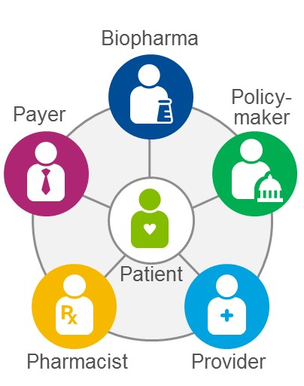
Demand: Healthcare system challenge
Cost/Time Sensitive Approaches
Stakeholders demand immediate, relevant evidence, collected efficiently at minimal cost
Evidentiary
Demands
MedTech
Evidentiary
Demands
Evidentiary
Demands
Demand for
Comprehensive Real World Evidence
Health care costs
Earlier & Cost Effective
Hospital
Evidentiary
Demands
Evidentiary
Demands
Evidentiary
Demands
Tighter Budgets + Networked Healthcare System =
Increased Demand for Comprehensive Evidence Development

Slide 58


Supply: Applying predictive analytics to realise novel insight
Generating novel insight with complex data
Driving clinical evidence-based decision-making
  Healthcare data is rapidly growing in complexity:
      New high-resolution data (e.g., biomarkers)
      Newly linked data (e.g., across care settings)
  Richer data presents exciting opportunities but also challenges
  Technology is driving improvements in diagnosis and targeted treatments (e.g., companion diagnostics)
  Pharma, payers and providers are increasingly partnering to develop and implement clinical decision-support tools
  Predictive analytics addresses many of these challenges enabling fresh opportunities to be realized
  Predictive analytics is critical to the success of this technology

Slide 59
Real World Evidence & Genomics are pushing new boundaries
“If real world evidence can be validated and studied in a randomized way, it could be used to support new indications, or expanded labeling, for existing therapies”
Janet Woodcock, FDA
Regulators are using RWE for safety & epi now – and considering broader adoption
Regulators and Payers have differing data needs from RWE and genomics
(approval alone is no guarantee of success)
The issue is that health technology assessment (HTA) bodies wanted different data than EMA was using to approve the drugs, such as data on rare adverse events and long-term efficacy.
Michael Mezher - Regulatory Affairs Professionals Society
These technologies include high performance computing and machine learning to infer the complex associations between patient data, genetic factors, demographic data, disease progression, and treatment options.
Technology makes massive computing and storage capabilities accessible to many

Slide 60
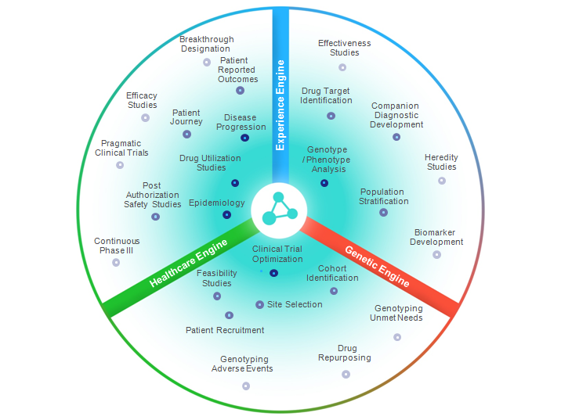
Precision medicine requires genomic, phenomic and care linkage
Clinical Decision Support
Translational Medicine
Precision Medicine

Slide 61
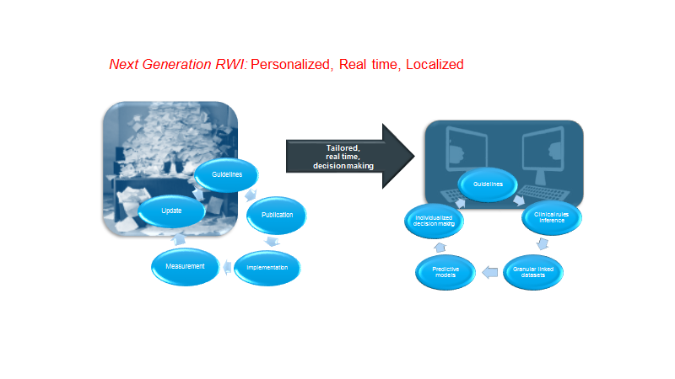
Challenges and solutions
“ It is estimated that the doubling time of medical knowledge in 1950 was 50 years; in 1980, 7 years; and in 2010, 3.5 years. In 2020 it is projected to be 0.2 years—just 73 days” (https://www.ncbi.nlm.nih.gov/pmc/articles/PMC3116346/)
Is GDPR the answer to the ask posed in Trustworthy reuse of health data?
https://www.sciencedirect.com/science/article/abs/pii/S138650561200202X

Slide 62
Case Biobanking

Slide 63
Derogations are allowed in the name of scientific research
Challenge: individual rights, e.g. notification, restriction of processing, object?
Safeguards to be provided by member state law?
challngearch aims
The GDPR and the research exemption: considerations on the necessary safeguards for research biobanks
Ciara Staunton ORCID: orcid.org/0000-0002-3185-440X¹,
Santa Slokenberga ORCID: orcid.org/0000-0002-5621-8485² &
Deborah Mascalzoni³
European Journal of Human Genetics volume 27, pages1159–1167(2019)
Biobank research is based on long-term organised collections of data and samples that can potentially be used for very diverse research aims
Classical tool relates consent to strong governance
Secondary use
“This review makes it clear that a full implementation of the derogations as provided for under the GDPR may render the research unethical and not in line with individuals interests”

Slide 64
status

Slide 65

General Data Protection Regulation shows results, but work needs to continue Press release24 July 2019Brussels
One continent, one law: Today, all but three Member States – Greece, Portugal and Slovenia
Businesses are adapting their practices: Compliance with the Regulation has helped companies increase the security of their data and develop privacy as a competitive advantage
Stronger role of data protection authorities: The Regulation has given national data protection authorities more powers to enforce the rules, yet limited # of fines yet
EU rules as reference for stronger data protection standards across the globe

