Slide 1
ISPOR New Professional Event: Career Advice Across the Globe
“Tips to secure your piece of the funding pie”
ISPOR Europe 2018
Monday, November 12, 2018
14:30-15:30 | Room: 129 + 130

Slide 2
Objectives
This session will provide an opportunity for New Professionals and graduating students to gain experience and good practices shared by HEOR experts about “Tips for securing your piece of the funding pie”
Upon completion of the presentations there will be time for Q&A and Networking.

Slide 3
Agenda
Time | Topic
14:30 – 14:35 | Speaker: Jason Cohen Manager, Member Services - Students & New Professionals Objectives, Overview of agenda, and Introductions
14:35 –14:45 | Speaker: Elisabeth Oehrlein, PhD, MS Senior Director, Research and Programs National Health Council, Washington, DC, USA ISPOR New Professionals
14:45 – 15:00 | Speaker: Isabelle Huys, LLMIPR Professor, KU Leuven, Leuven, Belgium
15:00 – 15:20 | Speaker: Zeba Khan, MS, RPh, PhD Vice President, Celgene, Summit, NJ, USA Student Network Advisor & Treasurer Board of Directors, ISPOR, Lawrenceville, NJ, USA
15:20 – 15:30 | Q&A/Final Comments/Adjourn

Slide 4
ISPOR New Professionals
Presenter:
Elisabeth Oehrlein, PhD, MS
Senior Director, Research and Programs
National Health Council, Washington, DC, USA

Slide 5
New Professional Overview
The ISPOR New Professionals Network is composed of recent graduates from HEOR related programs. The membership is available to former student ISPOR members and any new members who join that possess 3 years or less of experience in the HEOR field.
Members will be eligible to renew for two additional years after they join before becoming standard ISPOR members. Current ISPOR members, paying the $150 Standard membership, are not eligible to downgrade their membership to New Professional.

Slide 6
New Professional Specific Benefits
Career Advice Across the Globe Event during ISPOR conferences;
Professional Development webinars to focus on building soft skills;
Networking opportunities at ISPOR conferences to meet with professionals and peers;
Access to the ISPOR Career Center;
Eligible to participate in special interest groups / task forces;
Free online access to FormularyDecisions.com;
Eligible to apply for ISPOR Travel Grants;
Notes:
New Professionals enjoy all the same benefits as our more seasoned members and the following benefits are exclusive to New Professionals

Slide 7
Summary of Academic Experience
PhD, Dept. Pharmaceutical Health Services Research at the University of Maryland School of Pharmacy
MS, Epidemiology and Public Health at the University of Maryland School of Medicine
BA, Franklin and Marshall College
Notes:
Chapter President
Committee member
Student Network Chair
Participant and leader on Special Interest Groups
How these opportunities have helped you with your career thus far.

Slide 8
Non-traditional HEOR Career Path
Founded in 1920, the National Health Council (NHC) is the only organization that brings together all segments of the health community to provide a united voice for the more than 160 million people with chronic diseases and disabilities and their family caregivers.
Made up of more than 125 diverse national health-related organizations and businesses, the NHC's core membership includes the nation’s leading patient advocacy organizations, which control its governance and policy-making process.
Other members include professional and membership associations; nonprofit organizations with an interest in health; and representatives from the pharmaceutical, generic drug, health insurance, device, and biotechnology industries.

Slide 9
Non-traditional HEOR Career Path
9

Slide 10
Non-traditional HEOR Career Path – but very relevant to HEOR
Clinical outcome assessment (PROs, ClinROs, etc.)
Health care financing
Health technology assessment
Patient-focused drug development
Real-world evidence
Reimbursement
Notes:
Importance of researchers contributing to policy decisions

Slide 11
How You Can Get Involved
Stay attuned to advances in HEOR
Webinars featuring authors from recent Value in Health publications
Networking
Complete the second annual New Professional Interest Survey when it is launched in early 2019;
What would you like to see?
This Photo by Unknown Author is licensed under CC BY-SA-NC

Slide 12
How You Can Get Involved
Submit your interest to be one of the first members on the New Professional Steering Committee when it is officially launched in 2019;
Volunteer to deliver a webinar to students that will highlight “A Day In The Life” or “My Career Path” to highlight how you decided to get into the HEOR field;
Email newprofessionals@ispor.org with questions or suggestions on how we can improve the member experience!
This Photo by Unknown Author is licensed under CC BY-SA-NC

Slide 13
ISPOR New Professional Event: Career Advice Across the Globe “Tips to secure your piece of the funding pie”
PRESENTER
1
Presenter:
Isabelle Huys, LLM IPR
Professor, KU Leuven, Leuven, Belgium

Slide 14
Summary of Academic Experience
PhD project on national funding in Belgium (Research Foundation Flanders)
Tech Transfer Officer
Research stay abroad in Munich (Germany) on German funding
Post-doc project on European funding
Tenure track position with national and institutional funding
Full Professor supervising PhD students funded from different sources
National/European funding
Private/public funding

Slide 15
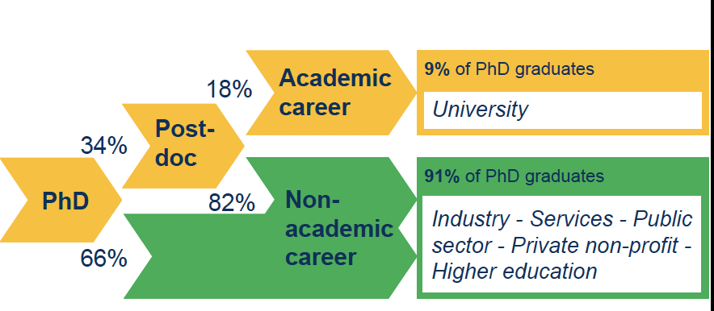
Summary of Academic Experience

Slide 16
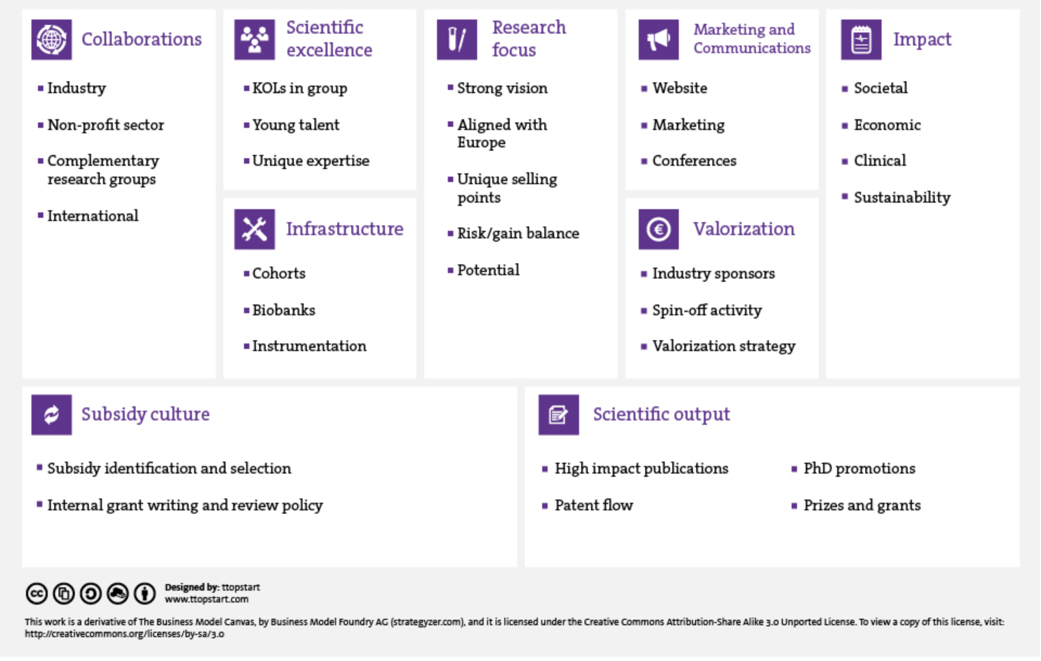
Securing Funding – Academic Perspective
Assets and network
Core activity
Output
Summary of Academic Experience
Currencies
Compliance
Integrity & ethics
Data management
16
https://ttopstart-academy.com/wp-content/uploads/2016/07/canvas-cc-01.jpg

Slide 17
Securing Funding – Academic Perspective
Project-based funding
Fundamental vs applied research
Start-up grants
Other initiatives, e.g. CELSA, …
Personal funding
Research professorships
PhD scholarships
Short term post-doc fellowships
Internal funding vs national funding vs EU vs international funding

Slide 18
Securing Funding – Academic Perspective
Internal funds as a leverage towards external funds
Fundamental research funds (e.g. Research Foundation Flanders) as leverage to Marie Sklodowska Curie, ERC, ESFRI project applications
Strategic applied research funds (e.g. Flanders’ Innovation and Entrepreneurship, Policy centers) as leverage to Horizon 2020 multi-partner projects, spin-offs, …
Research funds for infrastructure (Hercules funding), travel, long/short research stay abroad, networking (COST Action)
Specific programs for tenure tracks or young academics

Slide 19
Securing Funding – Academic Perspective
Many trees in the EU forest
Framework Programme (85% of international funds): FP, ERC, MCA, PHC, FoF, KET, FET, LEIT, EIT, H2020
National (co-)funding for European Collaboration: JPI, JTI, ERA-NET, ERA-NET+
Market-drive research: COSME, EUROSTARS, …
Policy-driven (DGs): ENV, JUSTICE, SANTE, …
Cohesion fund, maritime fund, networking, teaming, twinning: COST, LIFE, EFRO, EMFF, …
Policy, coordination, industry: EIP, ETP
Foundations
Funding outside EU: NIH

Slide 20
Good practices for submitting a grant proposal
Scientific quality is the first criterium
Strict pursuit of deadlines
Know your institution and its supporting departments or committees
KU Leuven/Tech Transfer Office/University Hospital departments (CTC)/ethics committee/…
Know strategic partners from your institution
Research centers
Understand the type of research you want to execute
Fundamental/applied/combination/Local/national/European/international/…
Project-based or mandate-based research
Think about your next funding during ongoing research project

Slide 22
Pitfalls to avoid
Unbalanced efforts
Too much pressure on yourself and on your collaborators (PhD students, Post-docs)
Postponement with initial face-to-face contacts
Inadequate of legal/budgetary checks
Lack of focus

Slide 23
How to stand out from peers
Courses on proposal writing
Make your SWOT analysis
Do benchmarking & find your uniqueness
Take strategic decisions
Make a funding roadmap (e.g. collaborations: COST; Scientific excellence: ERC, ITN; research focus: research and valorization grants)

Slide 24
Regional considerations that students should take into account based on where they are applying
Language differences (e.g. presentations)
Type of applicants
Pure academic consortium vs mixed academic/SMEs vs academic/big pharma, …
Number of applicants
Single, multiple partners, minimum number of applicants (3 per MS)
Focus of research topic (e.g. FWO)
Legal obligations
Clinical research: local ethics committees
Personal data: national legislations
Biological material: Nagoya Protocol

Slide 25
Case Study Example
Define research idea and funding needs (personal funding, equipment/ infrastructure/ travel/ networking)
OR: Look for calls for funding and consider the topics
Identify funding opportunities that match the research idea
Websites (of own institution or of funding agency); Information sessions; Personal guidance
Project design
Match the project to the funding scheme
Proposal writing
Create the consortium
Customize yourself with writing tips & trics specific for the funding scheme (Workshops and trainings; Proofreading of proposals)

Slide 26
Case Study Example
Administration
Design your budget; Legal advice, i.e. Intellectual property rights, consortium agreement; Data management
Estimate your chances for success
Keep contacts with the consortium members after submission

Slide 27
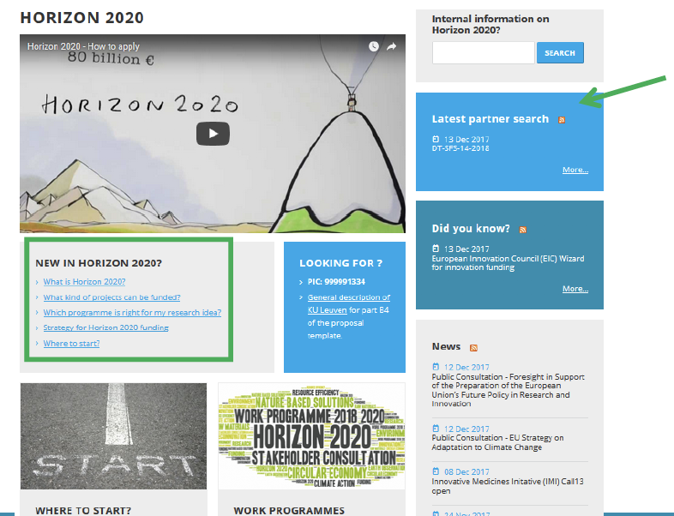
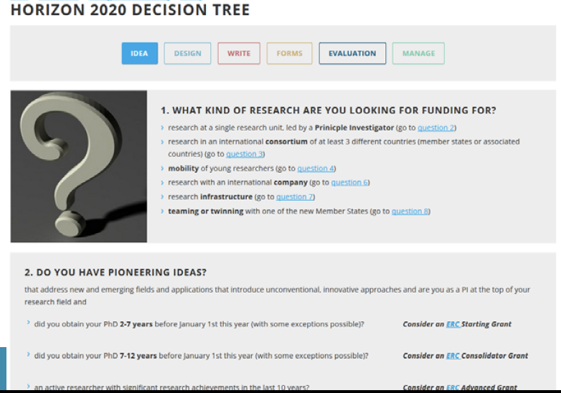
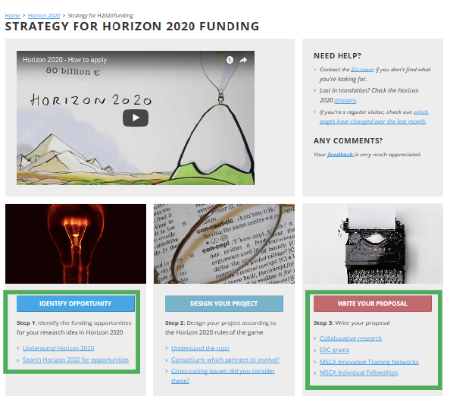

Slide 28
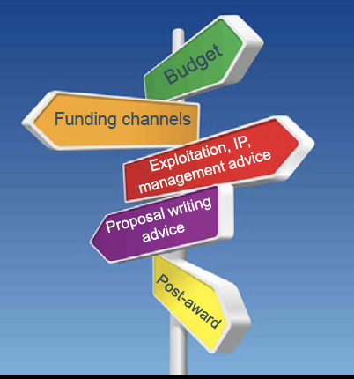

Slide 29
ISPOR New Professional Event: Career Advice Across the Globe “Tips to Secure Your Piece of the Funding Pie”
PRESENTER
2
Presenter:
Zeba M. Khan, RPh, PhD
Vice President, Celgene, Summit, NJ, USA
Student Network Advisor & Treasurer Board of Directors, ISPOR, Lawrenceville, NJ, USA

Slide 30
Summary of Academic Experience
Clinical Pharmacist
MS and PhD
Transitioned to Pharmaceutical Industry
GSK (Research Triangle Park, NC, USA)
Novartis (Basel, Switzerland)
Novartis (East Hanover, NJ, USA)
Celgene (Summit, NJ, USA)
Led various roles including: HEOR, Health Care Management, Pricing and Market Access, Public Policy, Corporate Responsibility, Global Health Access

Slide 31
Securing Funding – Industry Perspective
Innovation is key
Align your proposal / initiative to business goals and strategies
Obtain input from experts and key stakeholders
Be brief and to the point
Show impact and implications across the business
Tailor communications to your key funding bodies

Slide 32
Good practices for submitting a funding proposal
Be direct and focused
Clear alignment to business goals and initiatives
Obtain input from and alignment with business partners
Show value added
Focus on deliverables to the business
Detailed timelines with milestones
Budgets
RACI (Responsible, Accountable, Consulted, and Informed)

Slide 33
Pitfalls to avoid
Overwhelming details
General proposals with no specific proof of concept or deliverables
Lack of focus on content of the proposal
Avoid operating in a vacuum
Be sure to put the proposal in the context of business deliverables
There’s no “y” in “ours”
Do not forget the timelines!
Notes:
Timelines: Gantt charts are your best friends

Slide 34
How to stand out from other departments requesting funding
Prioritization
Alignment
Collaboration
Communication
Partnership

Slide 35
Regional considerations that students should take into account based on where they are applying
Understand rules and regulations for specific countries
Global, Regional, Local needs
Alignment
Process
Culture
Notes:
Health Care Practitioners (HCPs)

Slide 36
Case Study Example
ISPOR Student Travel Grants
30 for US
10 for Europe
10 for Regional Conference
$1,100 to $1,300 funding

Slide 37
ISPOR New Professional Event: Career Advice Across the Globe
Q&A Period
Monday, November 12, 2018
14:30-15:30 | Room: 316-317
Notes:
A bowl to collect cards with topics of interest or suggestions for New Professional activities.

